Slide 1
Frameworks and tools for modeling serological data
Introduction to serosolver and serosim
James Hay
james.hay@ndm.ox.ac.uk
@jameshay218

Slide 3
Outline (should be ~2 hours)
Brief introduction to serodynamics (10 minutes)
Practical 1: familiarisation with serosim (45 minutes)
We’ll simulate a paired-sample longitudinal serosurvey of children in a rural/urban population with random infections and vaccinations, waning antibody titers, antibody-mediated immunity, and antibodies to one antigen measured on a truncated, continuous, noisy assay
Practical 2: Rsero
Practical 3: fitting serosolver to our simulated data (30 minutes)
We’ll estimate the exposure histories and antibody kinetics from our simulated dataset using serosolver to see how well an overly simple model estimates ground truth

Slide 4
Questions we’d like to answer with serological data
Serostatus – was this person previously infected?
What is the time-since-infection of a sample?
Back-calculated infection time from magnitude
First in HIV based on algorithms/combinations of assays, now across human and wildlife seroepi
What were the historical dynamics (infections, vaccination etc) which led to the current serological landscape?
Aggregation of times-since-infection, many links to survival analysis
Many methods rely on age as the time dimension (assume constant or simple FOI)
Can use age and real-time information
What can we learn about immunological mechanisms based on the distribution of biomarker levels?
Cohort studies, animal models, human challenge studies
Can we infer correlates of protection?
Event rate as function of something measurable
Can we quantify the current immune landscape of a particular pathogen?
Antibody landscapes across antigenic space
Vaccination coverage
Hay, J., Routledge, I., & Takahashi, S. 2023. osf.io/kqdsn

Slide 5
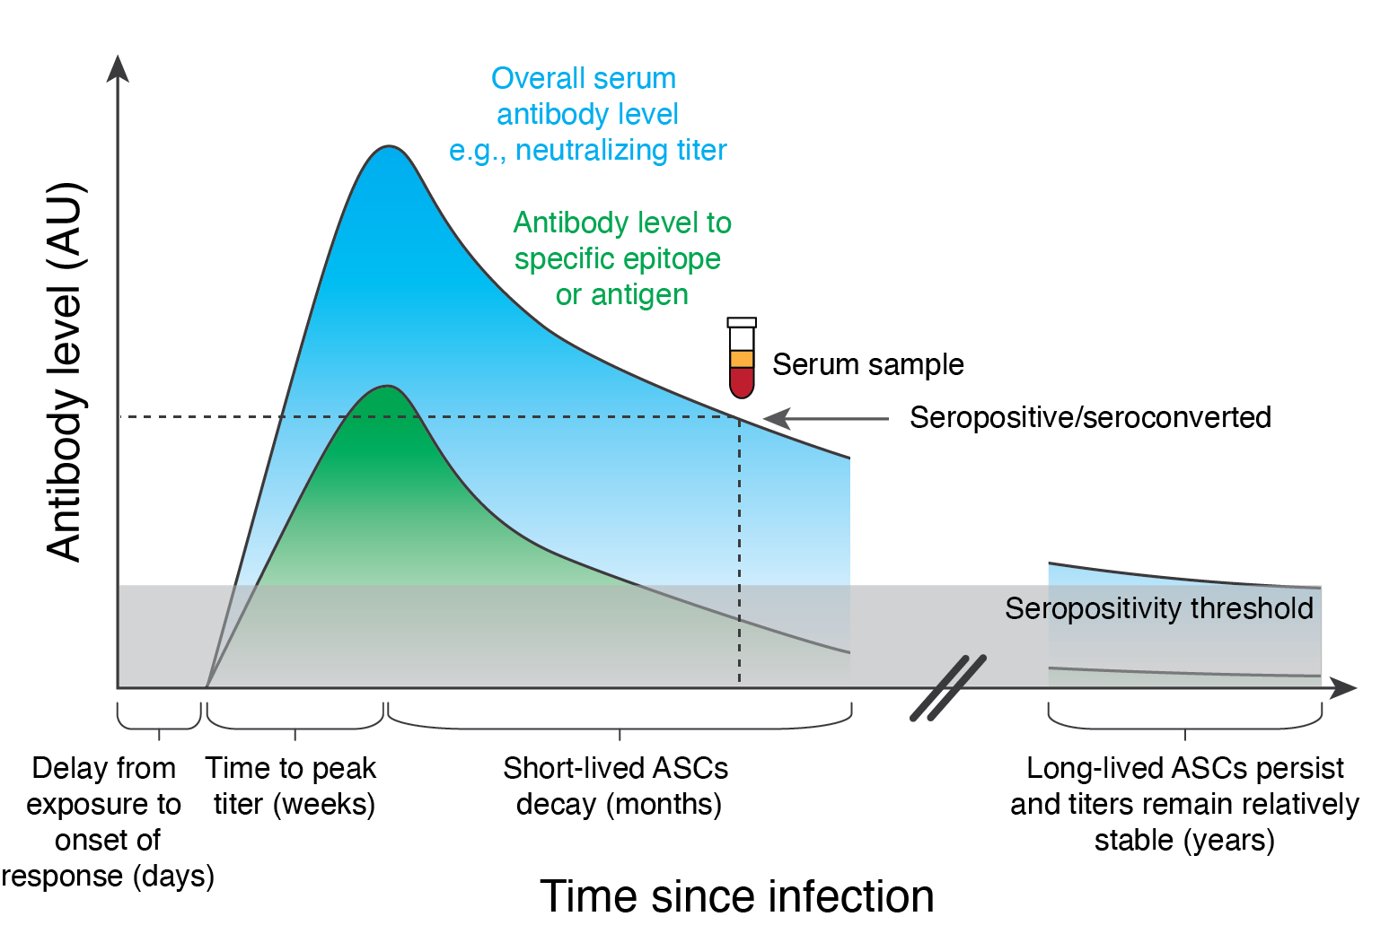
Some key modeling terms
Serostatus/seropositive: having measured antibody levels above some threshold
Seroprevalence: proportion of population who are seropositive
Time-since-infection: time between the (hidden) exposure event and the observation time AKA age-of-infection
Antibody kinetics: set of within-host dynamical processes which lead to time-varying antibody levels

Slide 6
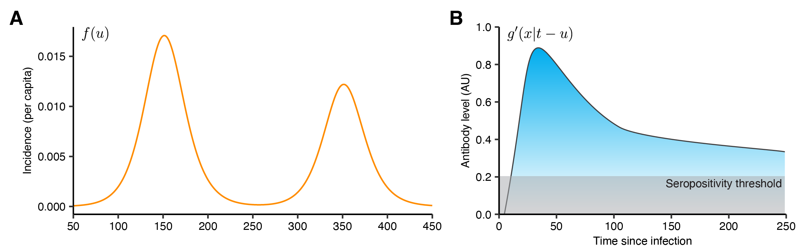
Biomarker data reflect the convolution of incidence and within-host kinetics process
Hay, J., Routledge, I., & Takahashi, S. 2023. osf.io/kqdsn

Slide 7

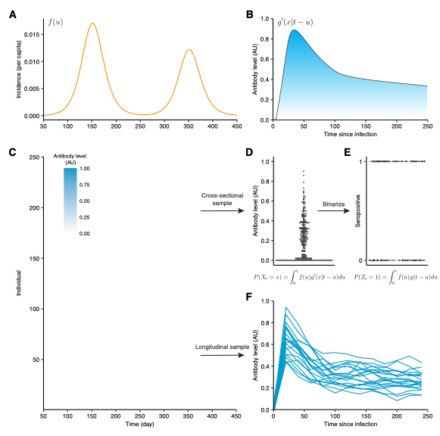
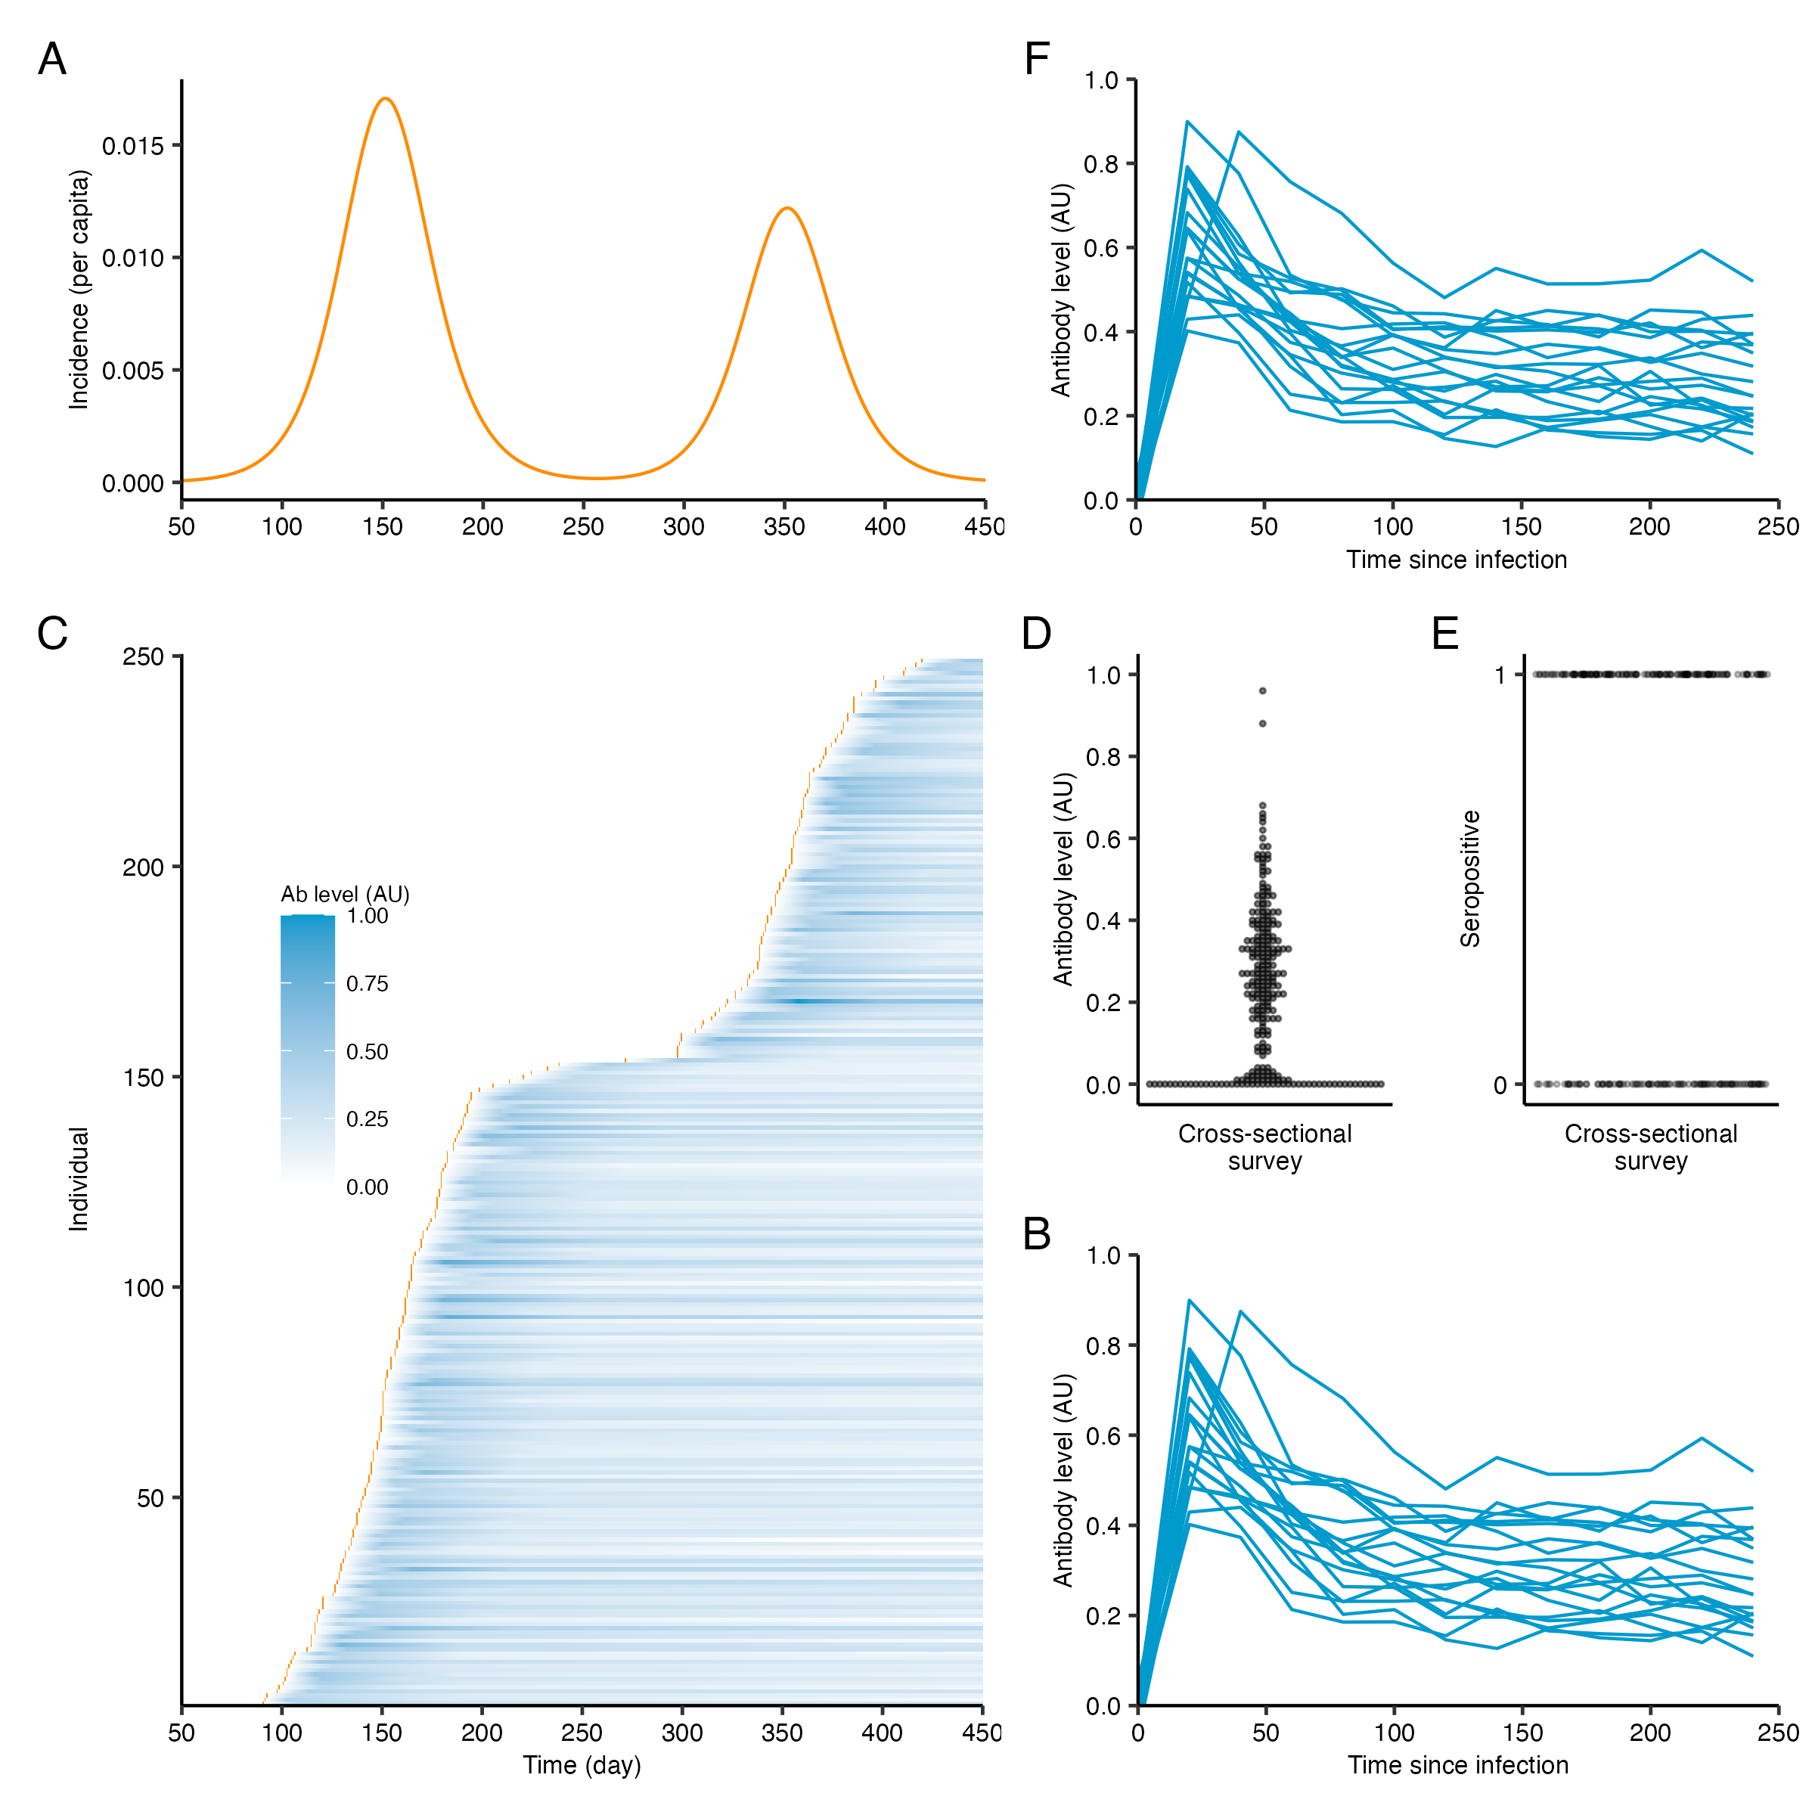
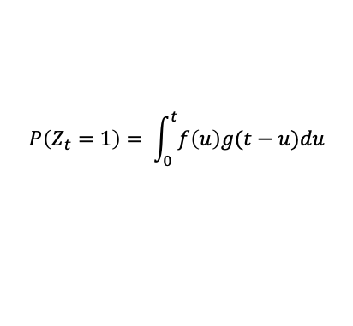
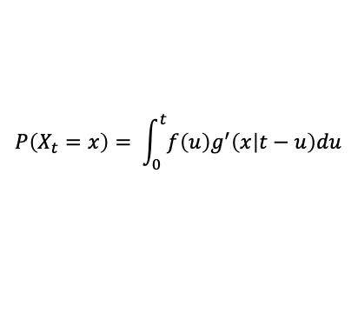
Biomarker data reflect the convolution of incidence and within-host kinetics process
Binarize
Cross-sectional survey
$$P\left(X_{t}=x\right)= \int_{0}^{t}{f\left(u\right)g^{′}\left(x | t−u\right)du}$$
$$P\left(Z_{t}=1\right)= \int_{0}^{t}{f\left(u\right)g(t−u)du}$$
Serocatalytic model is a special case
Longitudinal cohort
See also Clapham et al. Emerg Infect Dis 2020
Hay, J., Routledge, I., & Takahashi, S. 2023. osf.io/kqdsn

Slide 8
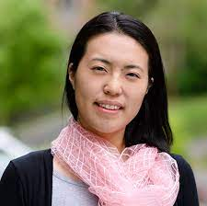
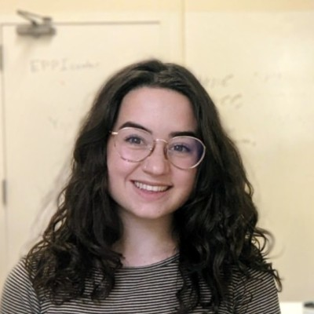
Current landscape of serodynamics methods
Saki Takahashi and Isobel Routledge
Serocatalytic
models
Antibody acquisition
models
Machine learning approaches
Multi-antigen
time-since-infection methods
Mixture/latent class
models
Time-since-infection methods
Complexity
Less complex
More complex
Hay, J., Routledge, I., & Takahashi, S. 2023. osf.io/kqdsn

Slide 9
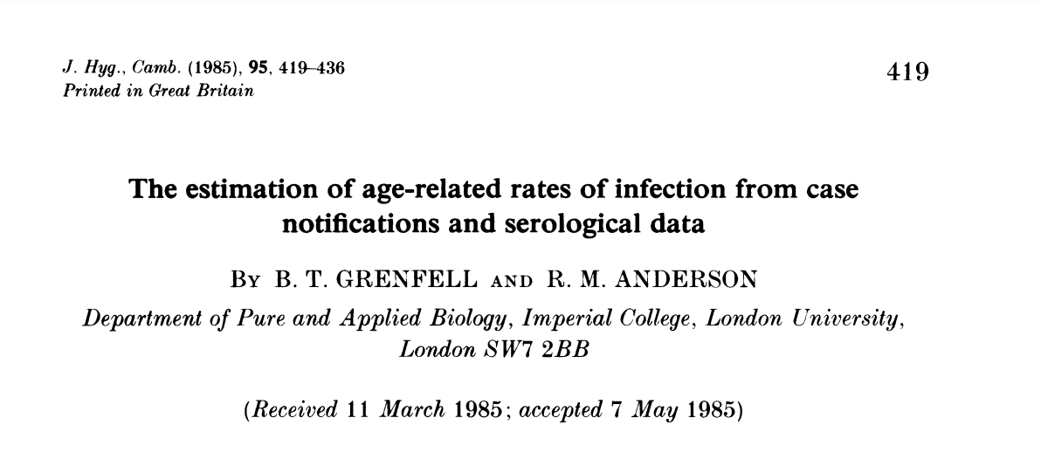
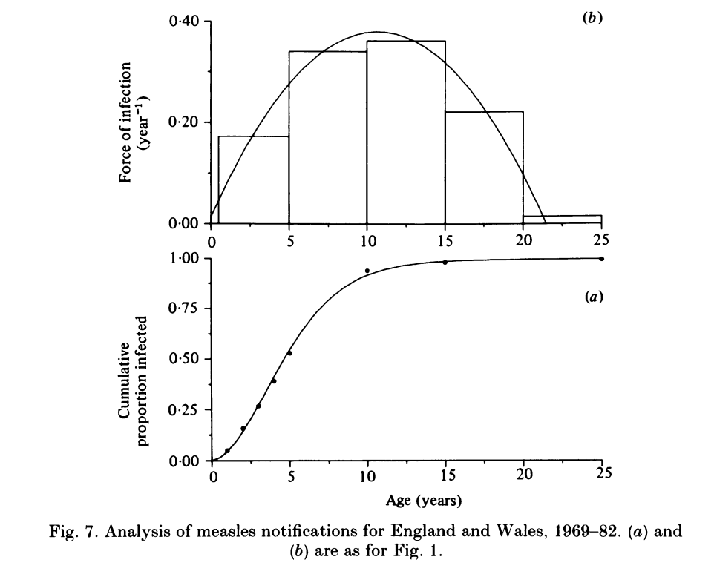
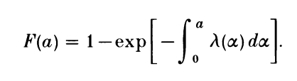
Current landscape of serodynamics methods
(Measles)
Grenfell and Anderson J. Hyg. Camb. (1985) 95. 419-436
Serocatalytic
models
Antibody acquisition
models
Machine learning approaches
Multi-antigen
time-since-infection methods
Mixture/latent class
models
Time-since-infection methods
Complexity
Less complex
More complex
Hay, J., Routledge, I., & Takahashi, S. 2023. osf.io/kqdsn

Slide 10
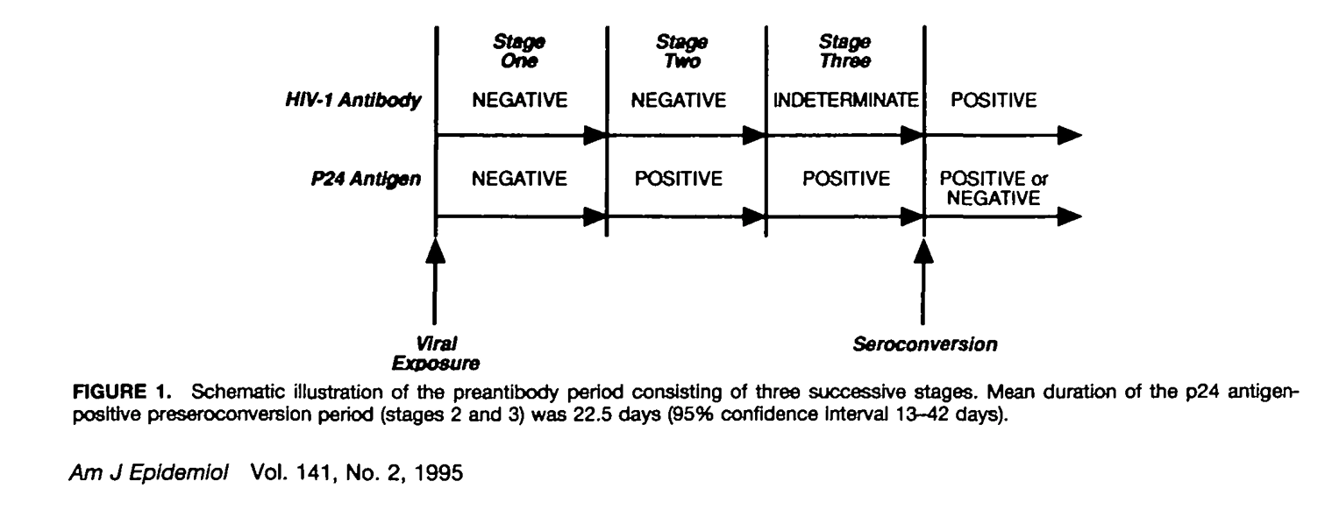
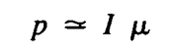
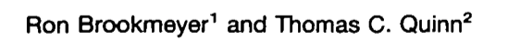
Current landscape of serodynamics methods
Incidence
(HIV)
Prevalence
Duration of window period
Duration of window period
Serocatalytic
models
Antibody acquisition
models
Machine learning approaches
Multi-antigen
time-since-infection methods
Mixture/latent class
models
Time-since-infection methods
Complexity
Less complex
More complex
Hay, J., Routledge, I., & Takahashi, S. 2023. osf.io/kqdsn

Slide 11
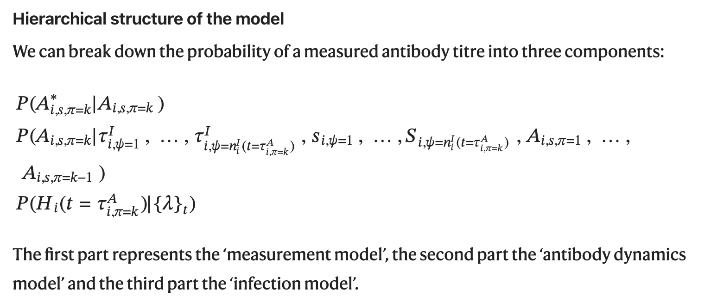
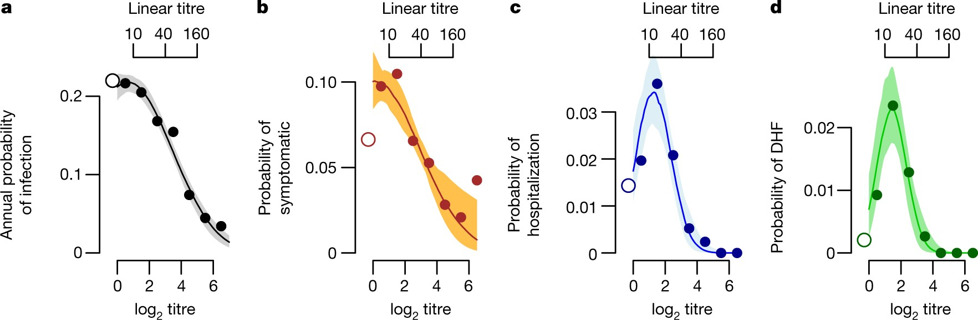
Current landscape of serodynamics methods
(Dengue)
Salje et al. Nature 2018 https://doi.org/10.1038/s41586-018-0157-4
Serocatalytic
models
Antibody acquisition
models
Machine learning approaches
Multi-antigen
time-since-infection methods
Mixture/latent class
models
Time-since-infection methods
11
Complexity
Less complex
More complex
Hay, J., Routledge, I., & Takahashi, S. 2023. osf.io/kqdsn

Slide 12
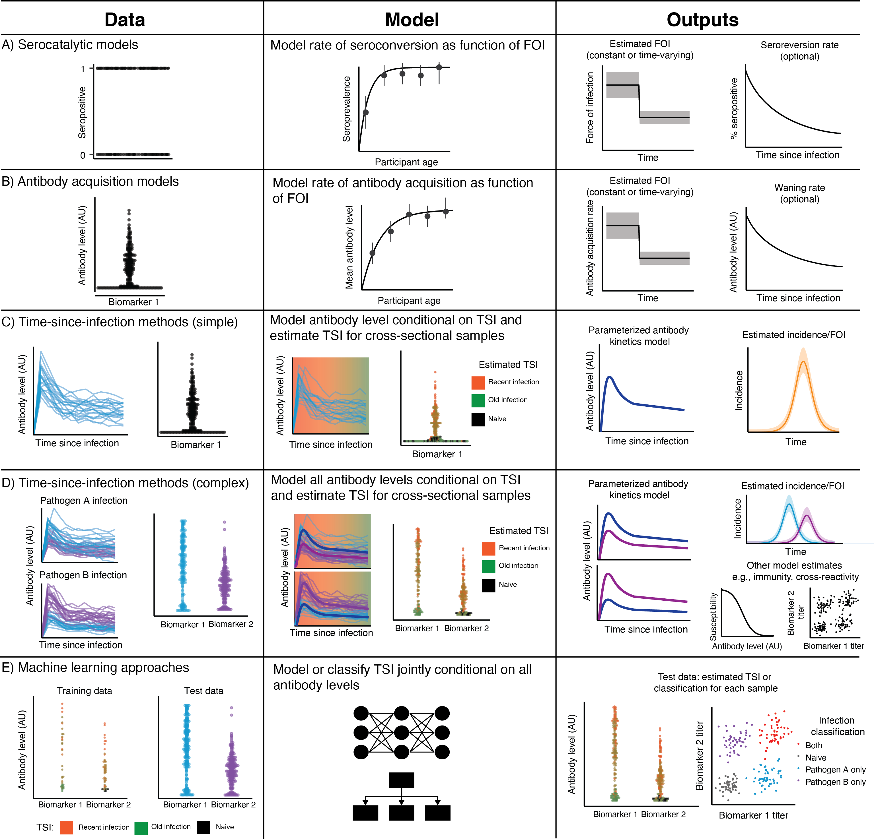
Hay, J., Routledge, I., & Takahashi, S. 2023. osf.io/kqdsn

Slide 13
Building an ecosystem of serodynamics tools
seroepirecipes
Best-practices and training
Review and codebase of analytical methods using serology
serosim
Antibody kinetics models
R package for simulating serosurvey data
serosolver
Other inference tools
General framework for inference using serology
Rsero
Serofoi/Epiverse
Reversible jump MCMC
How to tackle multiplex serology?

Slide 14
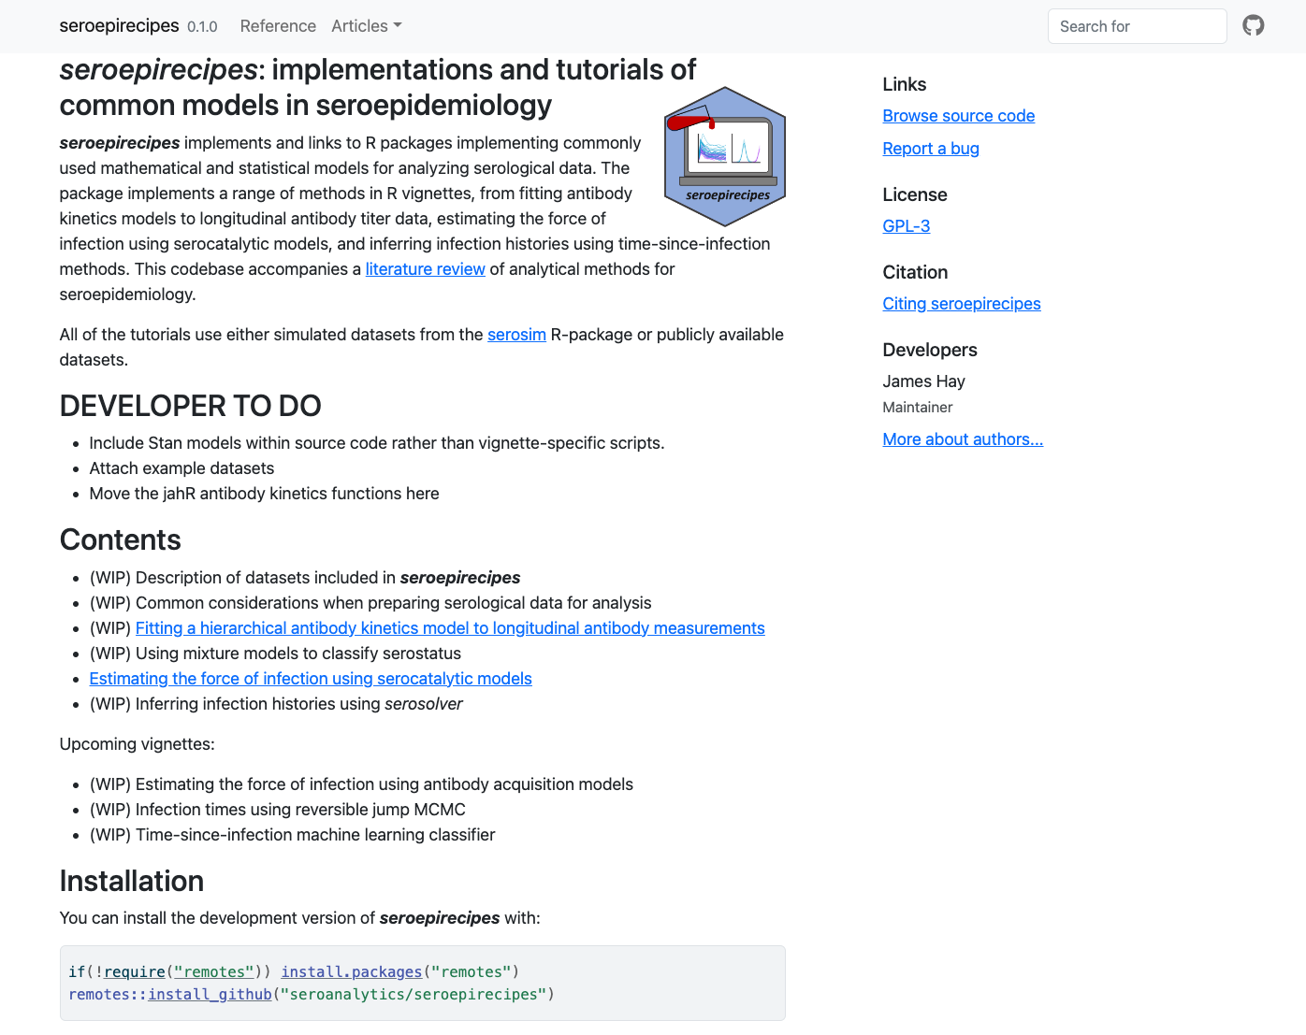

Slide 15
Challenges for modeling
We want to use serology to parameterize our models and estimate e.g., seroprevalence
The data-generating process is highly multileveled and stochastic
Within-host kinetics are hidden and complex, and poorly understood for many pathogens
Cross-reactivity within and between pathogen: is a signal due to exposure with the antigen of interest, or off-target?
Samples and measurements are often “what you can get”, not what you are trying to model
Assays are validated on samples, not populations. Real world test performance != manufacturer specification
Inference accounting for various biases and sources of variation leads to complex, large parameter spaces

Slide 16
How can we know if our inferences are being biased by these complex, hidden processes?

Slide 17
Practical 1: serosim

Slide 18



Arthur Menezes
Saki Takahashi Isobel Routledge
Jessica Metcalf Andrea Graham
serosim is an open-source R package designed to aid inference from serological surveys, by simulating data arising from user-specified vaccine and infection-generated antibody kinetics processes using a random effects model.
https://github.com/seroanalytics/serosim
https://seroanalytics.github.io/serosim/
Menezes et al. PLOS Comp Biol 2023
Notes:
Ultimately, serosim is an …….

Slide 19
Use cases
1. Plan serosurvey sampling strategies by simulating various observation processes and analyzing the inferences that can be made given the quality of the generated data (e.g., power analyses).
2. Uncover the underlying immunological and epidemiological mechanisms responsible for observed biomarkers (e.g., antibody titers) by comparing simulations to existing serological survey results.
3. Generate synthetic serological data from complex, user-specified generative models to assess the performance and trade-offs of inference models.
Notes:
1: I wanted go through 3 main use cases that we think serosim will be useful for so that you can have these in the back of your mind as we move foreword.

Slide 20
General ideas
Envisaged users are researchers due to complexity, but interested to hear use cases
Discrete time model
Allow users to write their own functions describing deterministic and stochastic generative processes as a function of time, biomarker state, demography etc
Idea is to use function pointers to plug-and-play different models at the different levels
Consider infections and exposures as Bernoulli trials and require the success probabilities to be defined
serosim produces exposure histories and latent antibody levels for all individuals for all times, which are subset to represent serosurveys
Default epi models are not dynamical (just prob of exposure over time), but possible
Many sources of variation: pathogen, exposure type, host, individual-level, infection history…

Slide 21
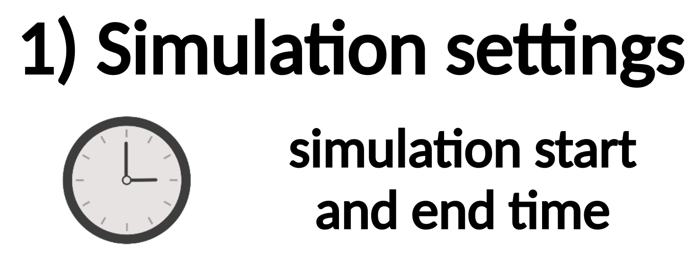
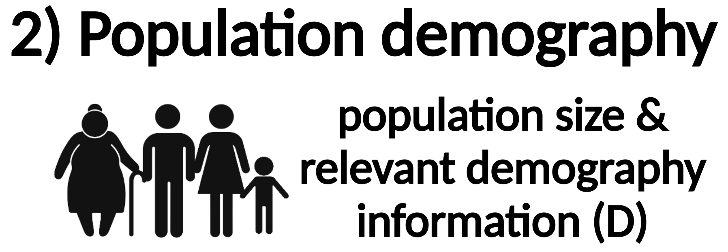
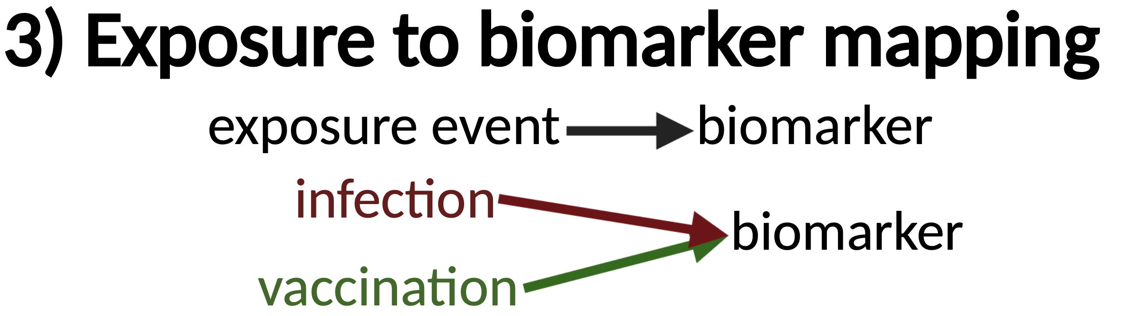
Inputs

Slide 22
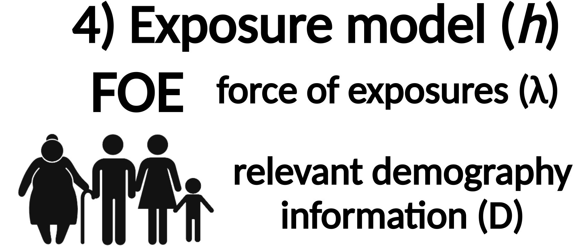
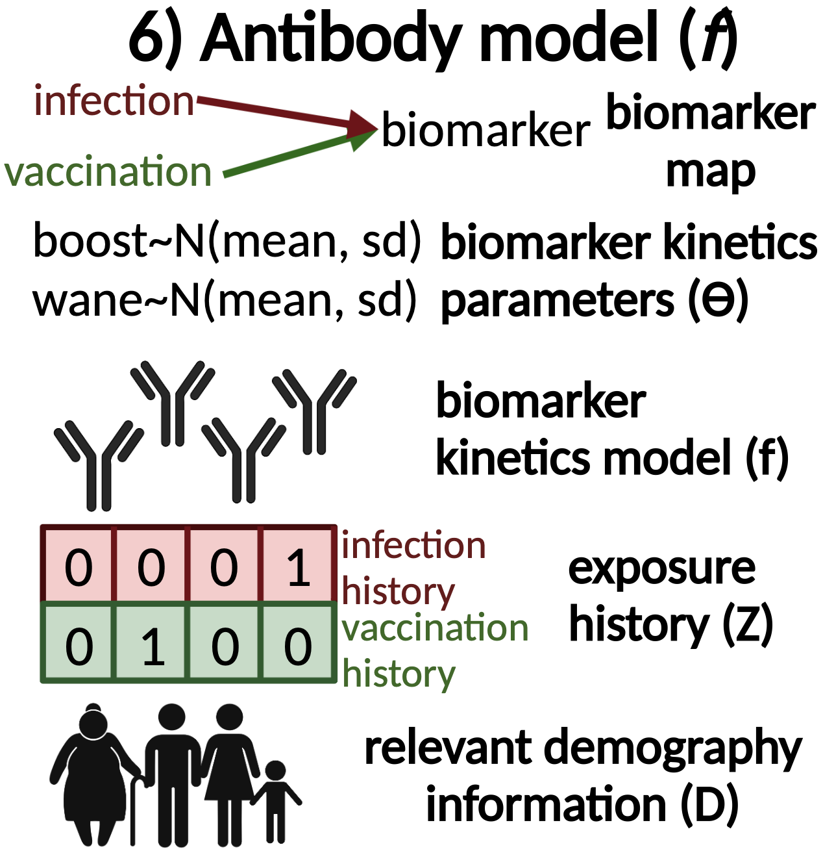
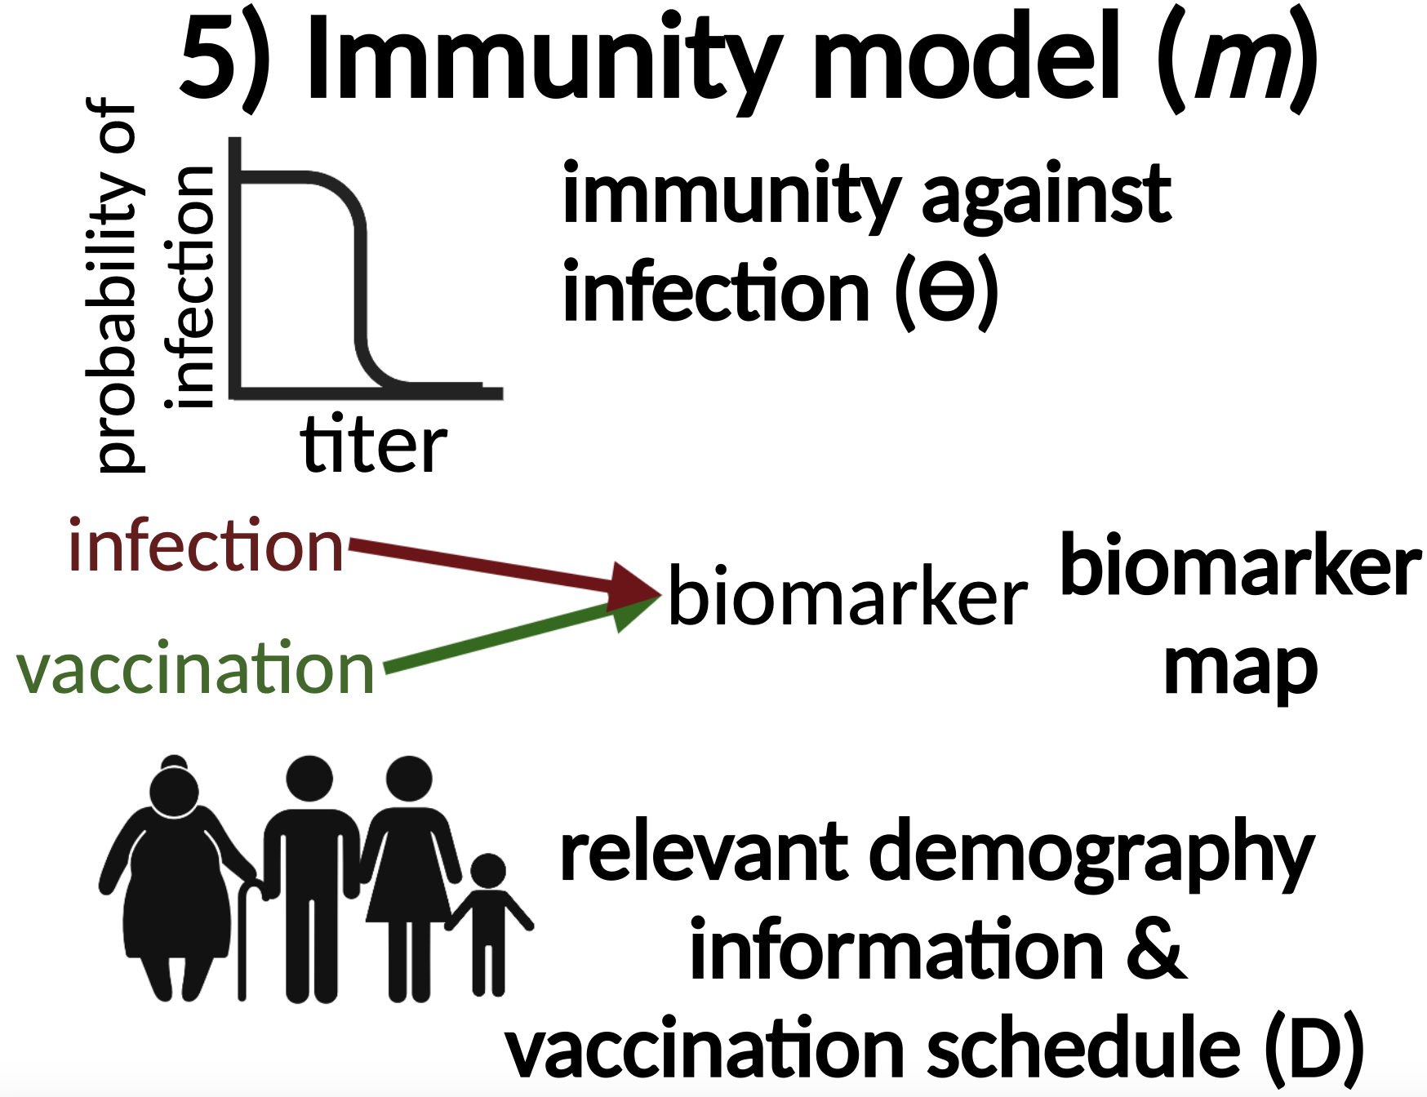
Inputs
Models
immune

Slide 23
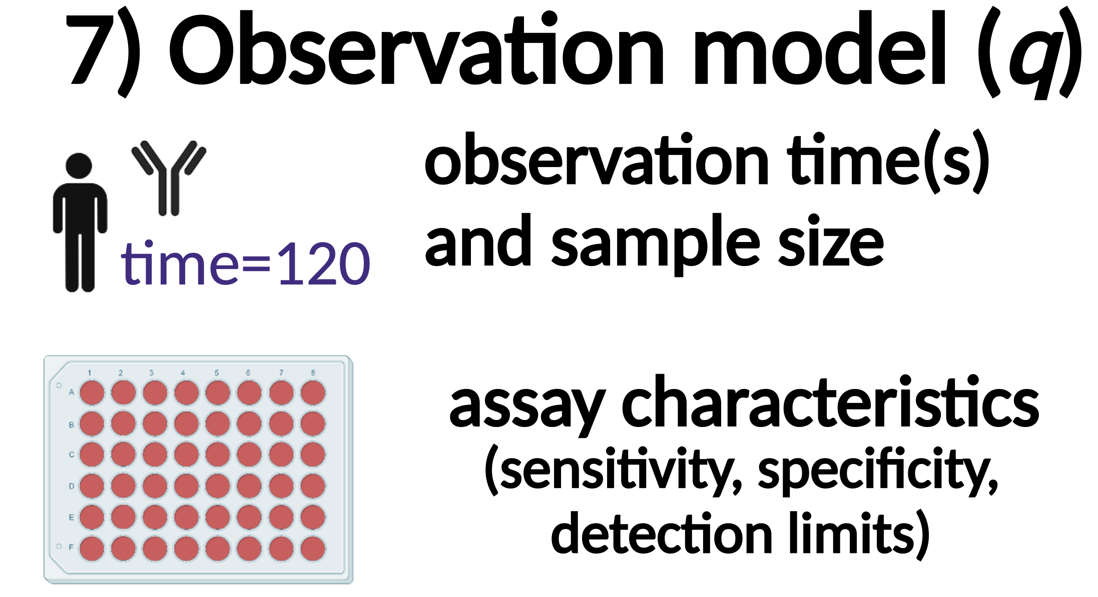
Inputs
Models
Outputs
immune

Slide 24
## Create necessary inputs
times <- seq(1,120,by=1)
demography <- generate_pop_demography(N=10, times=times, prob_removal=0)
biomarker_map <- tibble(exposure_id=c(1,2),biomarker_id=c(1,1))
foe_pars <- array(0, dim=c(1,max(times),n_distinct(biomarker_map$exposure_id)))
foe_pars[,,1] <- 0.01
foe_pars[,,2] <- 0.1
model_pars <- read.csv(file = filename, header = TRUE)
## Run main function
res<- runserosim(simulation_settings=list("t_start"=1,"t_end"=max(times)),demography,
observation_times=tibble(i=1:max(demography$i),t=120, b=1),
foe_pars, biomarker_map, model_pars,
exposure_model=exposure_model_simple_FOE,
immunity_model=immunity_model_vacc_ifxn_simple,
antibody_model=antibody_model_monophasic,
observation_model=observation_model_continuous_noise,
draw_parameters=draw_parameters_random_fx,
## Other arguments needed
max_events=c(1,1),
vacc_exposures=2,
vacc_age=c(NA,9),
sensitivity=0.85,
specificity=0.9)
Notes:
Now that we have gone through all of the required inputs… let’s take another look at how we would run this simulation

Slide 25
This simulation
Aim is to get a feel for the different levels of serosim
We’ll simulate a fake serosurvey assuming:
N=250 with varying ages, demography and attrition
Simulate for 120 months
Individuals get up to two doses of vaccine and multiple natural infections governed by a vaccination schedule and location-specific FOI
Both vaccination and infection boost antibody levels to a single measured biomarker which wanes
Immunity is controlled through a titer-dependent susceptibility model
Random-effects on the boosting and waning parameters
Individuals have up to 2 samples taken each, with some missingness
Observations are noisy and bounded by the assay, and sensitivity and specificity are imperfect
Assess how well different seroconversion thresholds perform at calling true exposures

Slide 26
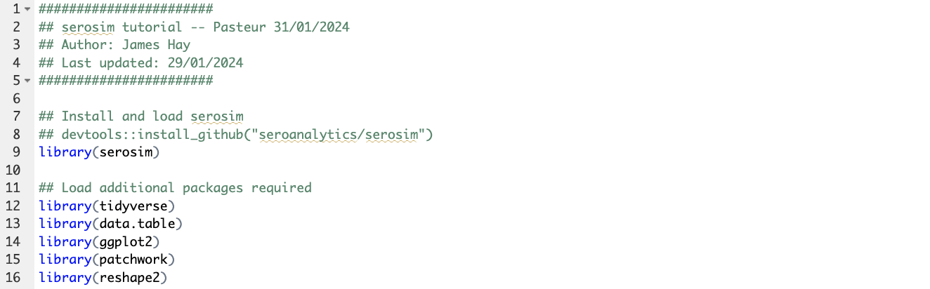

Slide 27

Notes:
Here, the user specifies the start and end time for the simulation. The model will simulate from the initial time point to the final time point in increments of one unless specified otherwise. These are arbitrary time steps selected by the user which will need to be scaled to the right time resolution to match any time-based parameters used in the model (e.g., antibody waning rates).
2) Users will specify the population size and have the option of specifying any population demographic elements of interest and relevance for the subsequent models like an individual’s socioeconomic status, nutritional status, sex, group, birth time, etc… via the demography argument.
3) Here, users specify the relationship between exposure event x and biomarker(s) b. Users will define the biomarker(s) affected by each exposure type within the exposure-to-biomarker map which follows a many-to-many relationship and tells the antibody model f which biomarker(s) (e.g., which specific antibody titers) will get boosted and tracked after each exposure event x, allowing for simulation of a diverse range of pathogen systems

Slide 28
N, birth time,
location
sex, etc.
t=1
t=120
Notes:
Here, the user specifies the start and end time for the simulation. The model will simulate from the initial time point to the final time point in increments of one unless specified otherwise. These are arbitrary time steps selected by the user which will need to be scaled to the right time resolution to match any time-based parameters used in the model (e.g., antibody waning rates).
2) Users will specify the population size and have the option of specifying any population demographic elements of interest and relevance for the subsequent models like an individual’s socioeconomic status, nutritional status, sex, group, birth time, etc… via the demography argument.
3) Here, users specify the relationship between exposure event x and biomarker(s) b. Users will define the biomarker(s) affected by each exposure type within the exposure-to-biomarker map which follows a many-to-many relationship and tells the antibody model f which biomarker(s) (e.g., which specific antibody titers) will get boosted and tracked after each exposure event x, allowing for simulation of a diverse range of pathogen systems

Slide 29
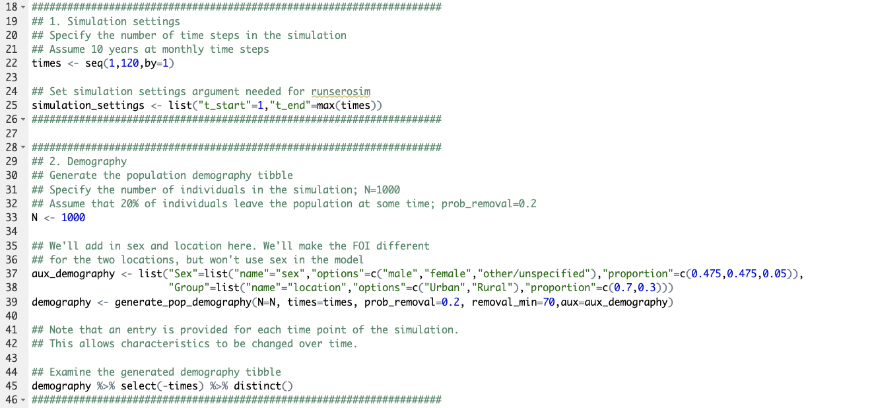

Slide 30
N, birth time,
location
sex, etc.
t=1
t=120
Notes:
Here, the user specifies the start and end time for the simulation. The model will simulate from the initial time point to the final time point in increments of one unless specified otherwise. These are arbitrary time steps selected by the user which will need to be scaled to the right time resolution to match any time-based parameters used in the model (e.g., antibody waning rates).
2) Users will specify the population size and have the option of specifying any population demographic elements of interest and relevance for the subsequent models like an individual’s socioeconomic status, nutritional status, sex, group, birth time, etc… via the demography argument.
3) Here, users specify the relationship between exposure event x and biomarker(s) b. Users will define the biomarker(s) affected by each exposure type within the exposure-to-biomarker map which follows a many-to-many relationship and tells the antibody model f which biomarker(s) (e.g., which specific antibody titers) will get boosted and tracked after each exposure event x, allowing for simulation of a diverse range of pathogen systems

Slide 31
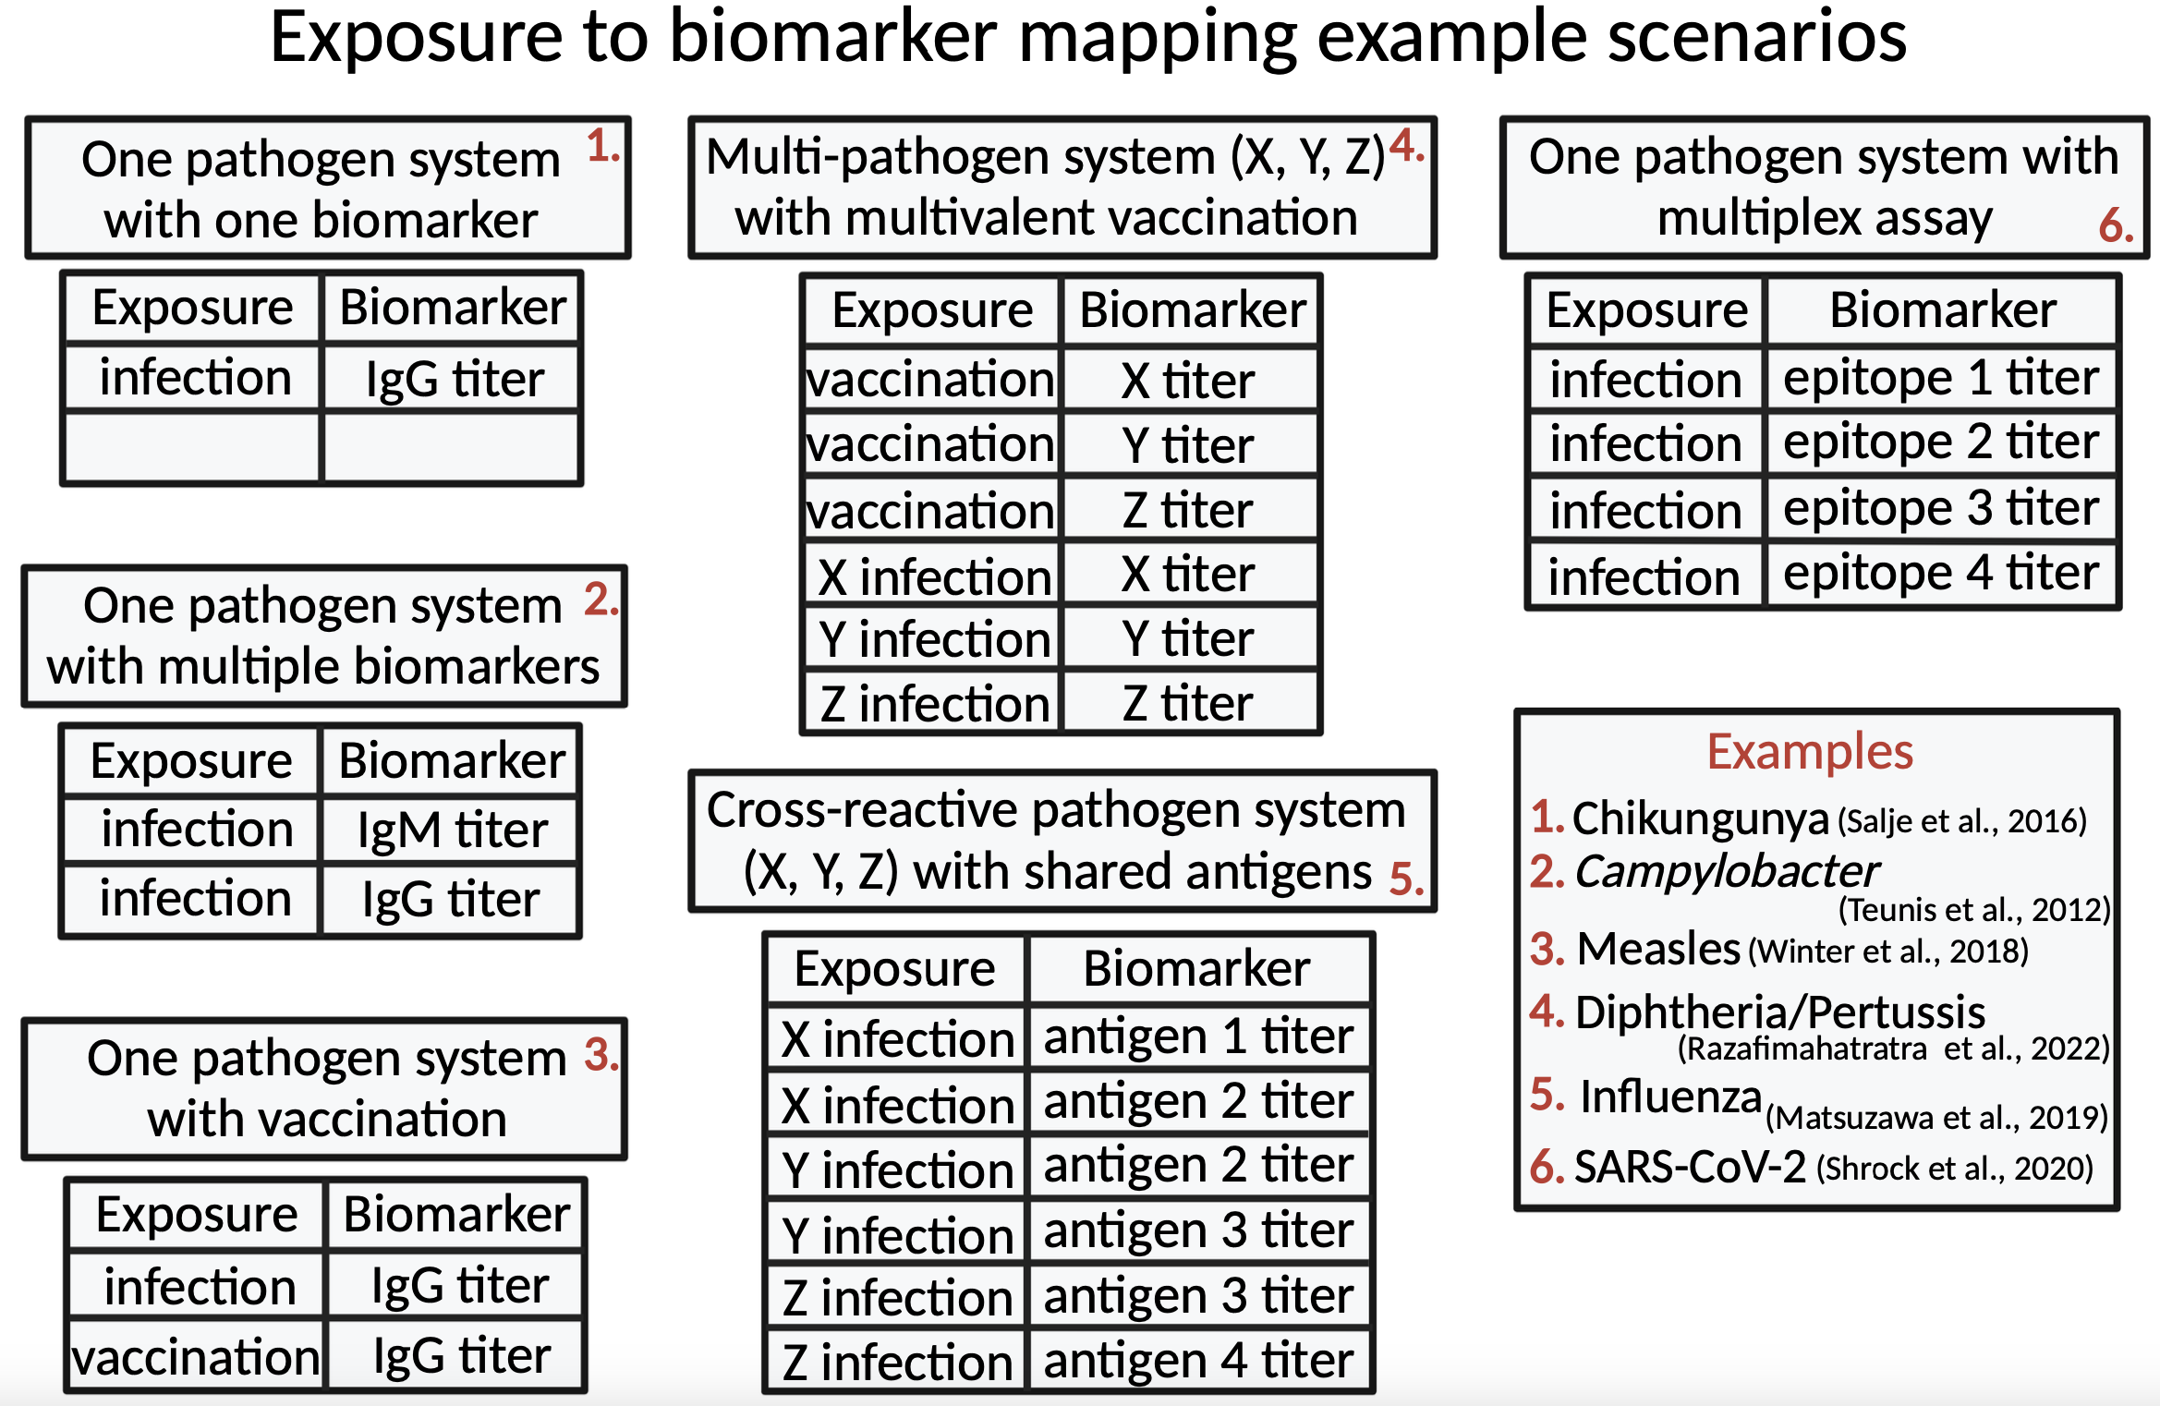
Notes:
This definition of exposure allows users to track vaccination, infection and re-infection events simultaneously but separately alongside the biomarkers produced as a result of different exposure events. Biomarkers b can represent antibodies binding the entire virus or a specific epitope depending on the user’s preference and assay characteristics.

Slide 32
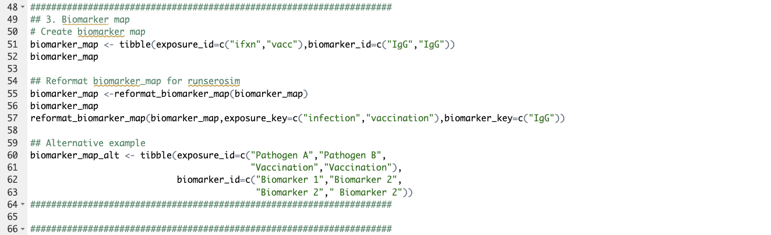

Slide 33
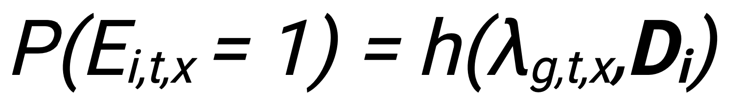

The exposure model determines the probability of an exposure event
Fixed FOE
Location-specific FOE
Demographic specific modifiers
$$1−e^{−λ}$$
Age specific effects
Simplest model
Varying levels of complexity
Complex model
Notes:
The exposure model h which will determine the probability that an individual i is exposed to an exposure event.
We distinguish between the probability of exposure (determined by the exposure model) and the probability of an exposure event generating a successful immunological response (determined by the immunity model), so that the latter can take into account important immunological and epidemiological considerations. For example, an individual’s probability of exposure to exposure event x which is specified at the population level might be different from their probability of becoming immunized conditional on what the actual exposure event is (vaccination, infection or re-infection) and any relevant factors (e.g. age, number of past vaccinations, current titer level, etc).
The force of the exposure event (lambda) argument is typically a three-dimensional array indicating the force of exposure for each exposure event in each group (if groups are specified within demography) in each time period.
Although this package does not include a suite of complex transmission models (e.g., complex SIR models), users can incorporate the outputs of their own preferred transmission model within runserosim. In lamda, users can input the force of infection generated from their transmission model into the exposure_id dimension associated with natural infection events. Users can also use the optional exposure_histories_fixed argument in runserosim to include prespecified information on an individual’s exposure history if known
The exposure model, specified by the exposure_model argument within runserosim, allows the user to determine which factors are relevant for an individual’s probability of exposure. The exposure model can vary in complexity with simpler versions calculating the probability of exposure by just taking the exposure event’s population level force of exposure into account and with more complex versions providing a functional transformation of the population level force of exposure given an individual's demographic information specified within demography. For example, an individual can be in a group (e.g., a location) where the force of exposure is 0.5 but their socio-economic status is high which might reduce their probability of exposure given that the disease is circulating less in that socio-economic class.

Slide 34
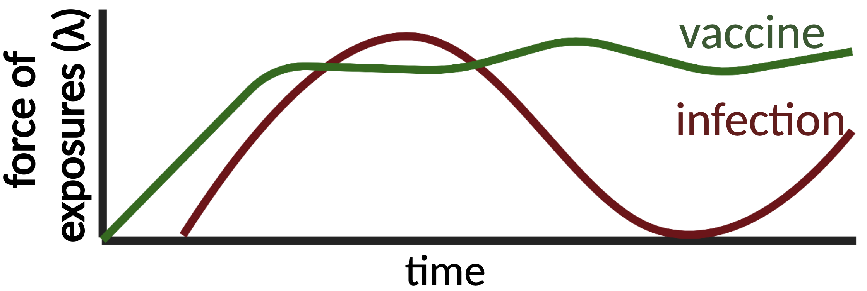
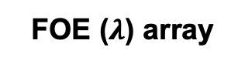
The exposure model determines the probability of an exposure event
Fixed FOE
Location-specific FOE
Demographic specific modifiers
$$1−e^{−λ}$$
Age specific effects
Simplest model
Varying levels of complexity
Complex model
FOE ($λ$) array
[,1,1] [,2,1] [,t_end,1]
[1,,1] 0.02 … …
[1,,2] 0.04 … …
[1,,3] 0.03 … …
Notes:
The exposure model h which will determine the probability that an individual i is exposed to an exposure event.
We distinguish between the probability of exposure (determined by the exposure model) and the probability of an exposure event generating a successful immunological response (determined by the immunity model), so that the latter can take into account important immunological and epidemiological considerations. For example, an individual’s probability of exposure to exposure event x which is specified at the population level might be different from their probability of becoming immunized conditional on what the actual exposure event is (vaccination, infection or re-infection) and any relevant factors (e.g. age, number of past vaccinations, current titer level, etc).
The force of the exposure event (lambda) argument is typically a three-dimensional array indicating the force of exposure for each exposure event in each group (if groups are specified within demography) in each time period.
Although this package does not include a suite of complex transmission models (e.g., complex SIR models), users can incorporate the outputs of their own preferred transmission model within runserosim. In lamda, users can input the force of infection generated from their transmission model into the exposure_id dimension associated with natural infection events. Users can also use the optional exposure_histories_fixed argument in runserosim to include prespecified information on an individual’s exposure history if known
The exposure model, specified by the exposure_model argument within runserosim, allows the user to determine which factors are relevant for an individual’s probability of exposure. The exposure model can vary in complexity with simpler versions calculating the probability of exposure by just taking the exposure event’s population level force of exposure into account and with more complex versions providing a functional transformation of the population level force of exposure given an individual's demographic information specified within demography. For example, an individual can be in a group (e.g., a location) where the force of exposure is 0.5 but their socio-economic status is high which might reduce their probability of exposure given that the disease is circulating less in that socio-economic class.

Slide 35
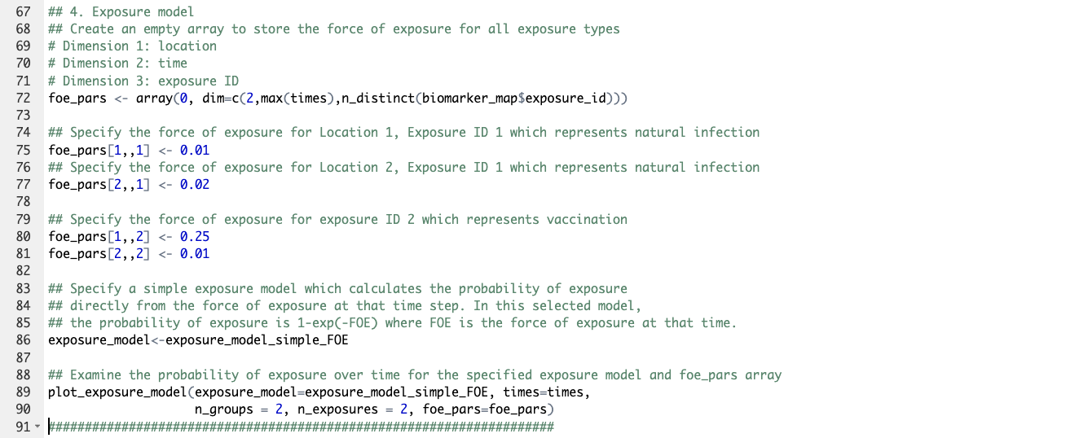
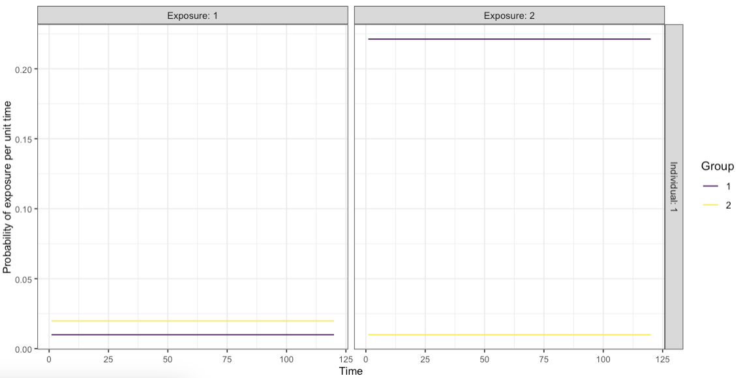

Slide 36
Probability of vaccination
Probability of exposure
t=1
t=120
Notes:
Next up we have the immunity model

Slide 37
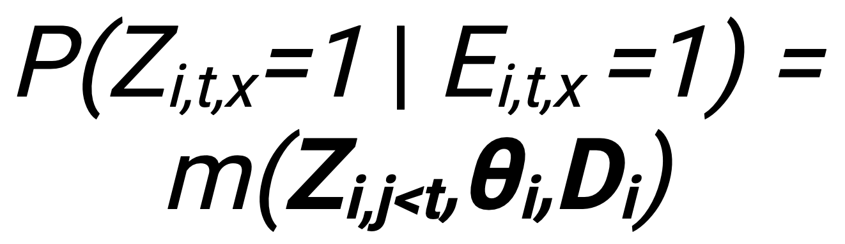
The immunity model determines whether an exposure event is successful
All exposures successful
Vaccination schedule and eligibility
Biomarker mediated protection
Ceiling on successful events
Time since last exposure
Simplest model
Varying levels of complexity
Complex model
Notes:
Which determines whether…..
where P(Zi,t,x=1| Ei,t,x=1), the probability of successful infection or vaccination of exposure event x given an exposure, is a function m of parameters specified within the immunity model. Z_{i,j<t} represents all successful infection/vaccination events at each timepoint j prior to time t (i.e., the exposure history), Ө_{i} represents the immunity model parameters and D_{i} represents any relevant demographic data
The immunity model can vary in complexity with simpler versions assuming all exposures are successful and with more complex versions taking into account what the exposure event is (e.g., a vaccination event or natural exposure to a pathogen), an individual’s past exposure history, current biomarker quantity and any relevant demography data.
Users can incorporate immunity from prior infection or vaccination and add limits to vaccine exposure events to prevent vaccinations after a completed series or before an individual is eligible.

Slide 38
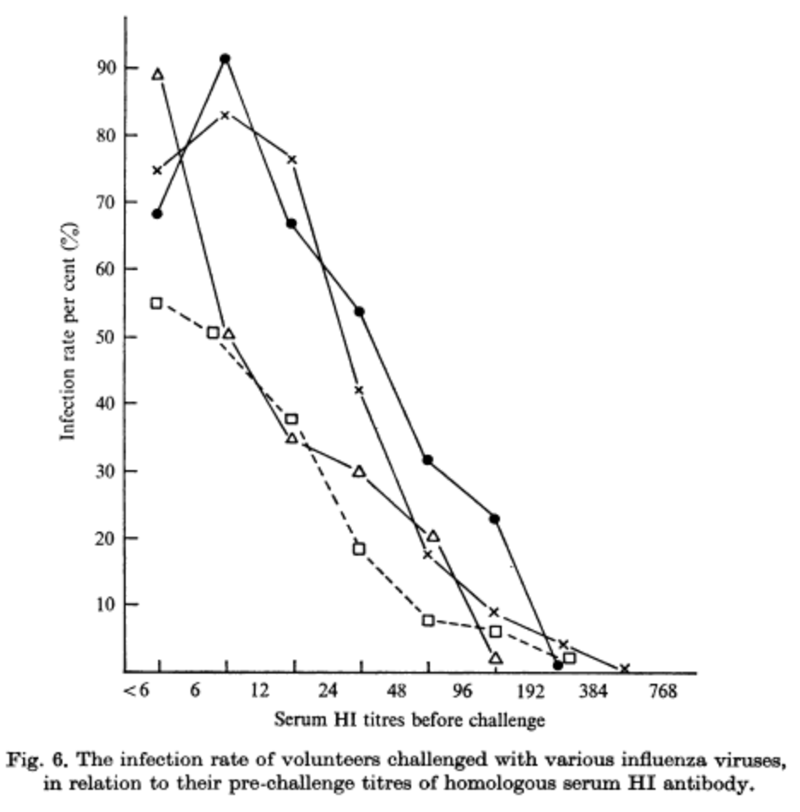
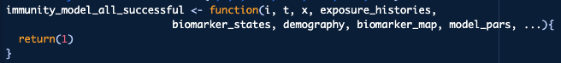
The immunity model determines whether an exposure event is successful
All exposures successful
Vaccination schedule and eligibility
Biomarker mediated protection
Ceiling on successful events
Time since last exposure
Simplest model
Varying levels of complexity
Complex model
Hobson et al. 1972 J Hyg (Lond) https://doi.org/10.1017%2Fs0022172400022610
Notes:
Which determines whether…..
where P(Zi,t,x=1| Ei,t,x=1), the probability of successful infection or vaccination of exposure event x given an exposure, is a function m of parameters specified within the immunity model. Z_{i,j<t} represents all successful infection/vaccination events at each timepoint j prior to time t (i.e., the exposure history), Ө_{i} represents the immunity model parameters and D_{i} represents any relevant demographic data
The immunity model can vary in complexity with simpler versions assuming all exposures are successful and with more complex versions taking into account what the exposure event is (e.g., a vaccination event or natural exposure to a pathogen), an individual’s past exposure history, current biomarker quantity and any relevant demography data.
Users can incorporate immunity from prior infection or vaccination and add limits to vaccine exposure events to prevent vaccinations after a completed series or before an individual is eligible.

Slide 39
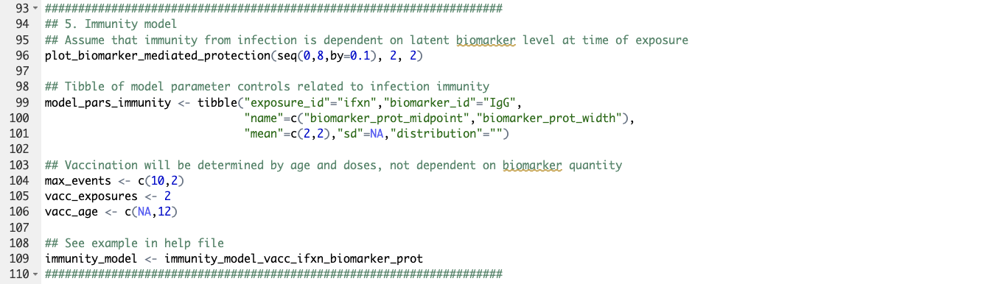
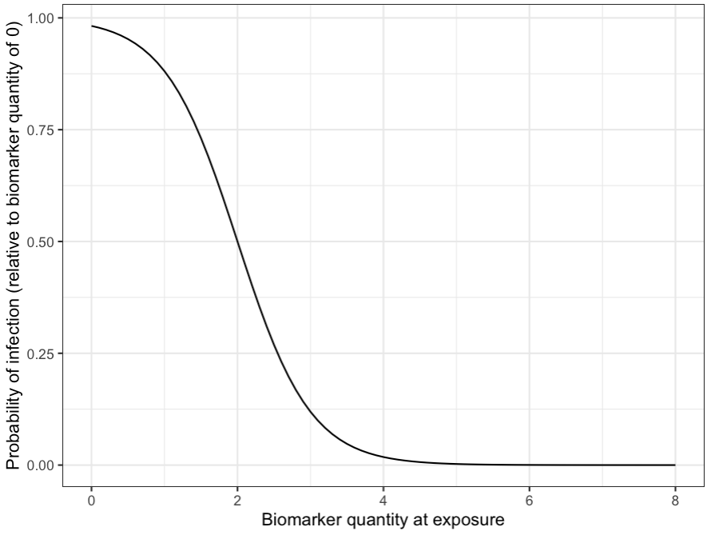

Slide 40
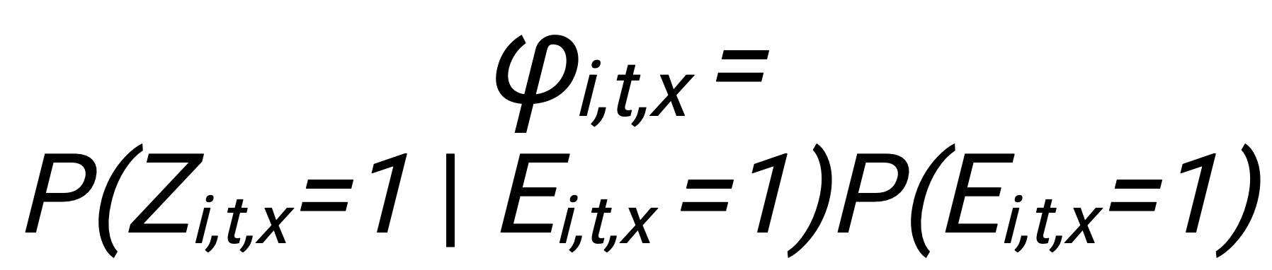
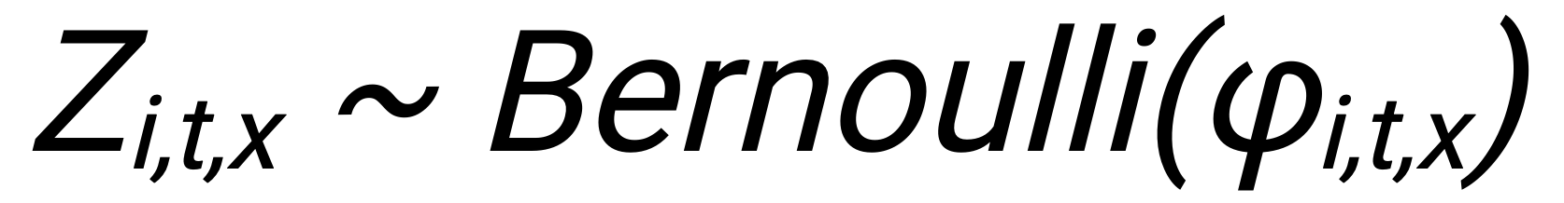
Probability of successful exposure:
Exposure history:
t=1
t=120
Notes:
Next up we have the immunity model

Slide 41
Probability of successful exposure:
Exposure history:
Immunity vs. infection
t=1
0 | 1 | 0 | 1 | 0 | 0 | 0 | 0 | 0 | 0 | 0 | 0 | 0 | 0 | 0 | 0 | 0 | 0 | 0 | 0 | 0
0 | 0 | 0 | 0 | 0 | 0 | 0 | 0 | 0 | 0 | 0 | 0 | 0 | 0 | 0 | 0 | 1 | 0 | 0 | 0 | 0
t=120
Notes:
Next up we have the immunity model

Slide 42
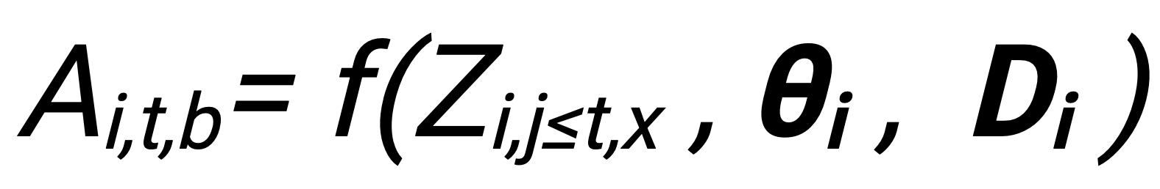
The antibody model tracks biomarker kinetics for each biomarker produced from successful exposure events.
Antibody ceiling effects, immune imprinting, random effects
Fixed effect
monophasic boosting-waning
Fixed effect
biphasic boosting-waning
Simplest model
Varying levels of complexity
Complex model
Notes:
Next up we have the immunity model

Slide 43
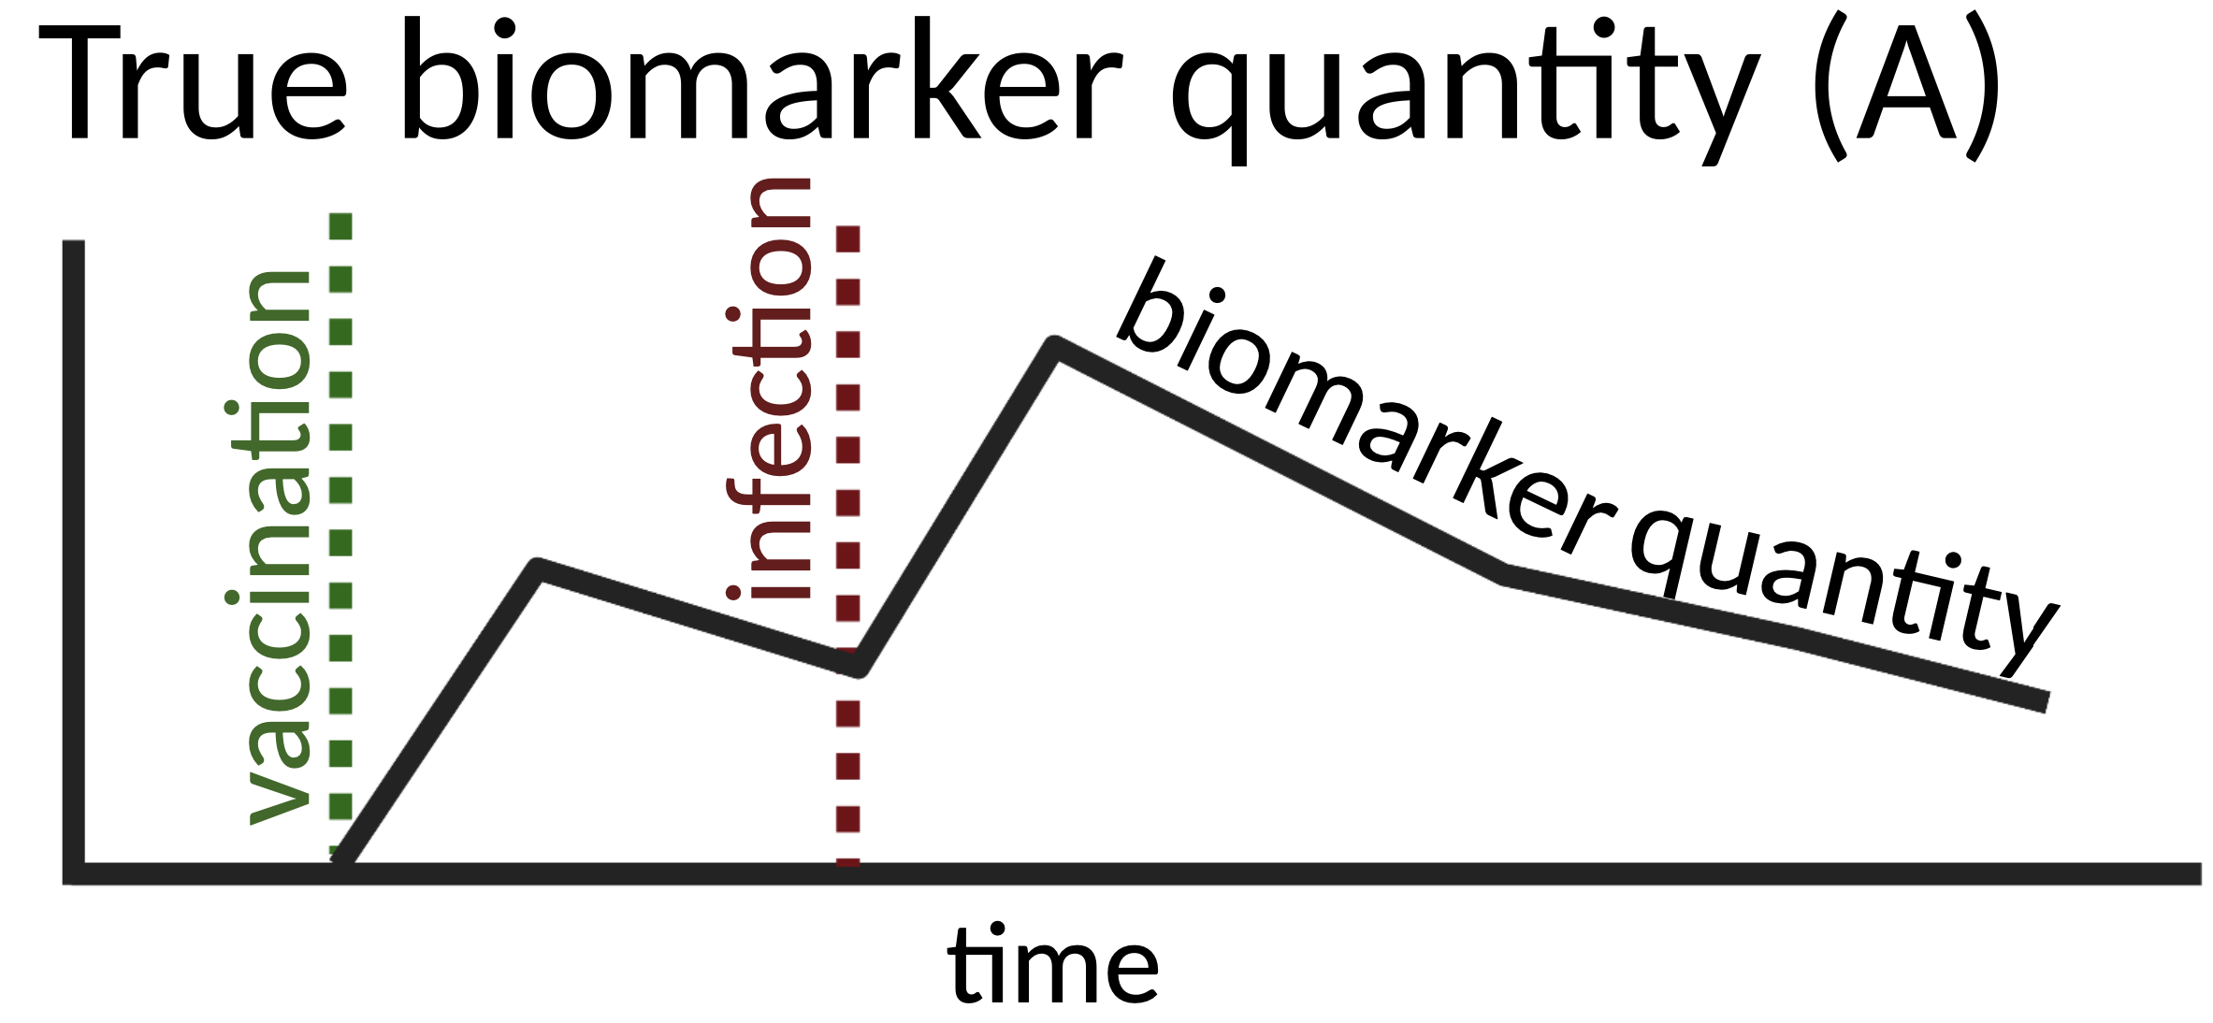
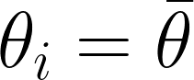
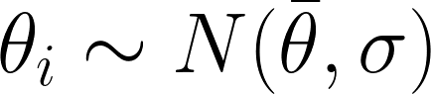
The antibody model tracks biomarker kinetics for each biomarker produced from successful exposure events.
Antibody ceiling effects, immune imprinting, random effects
Fixed effect
monophasic boosting-waning
Fixed effect
biphasic boosting-waning
Simplest model
Varying levels of complexity
Complex model
True biomarker quantity (A)
Vaccination
Infection
draw_parameters function
Notes:
Next up we have the immunity model

Slide 44
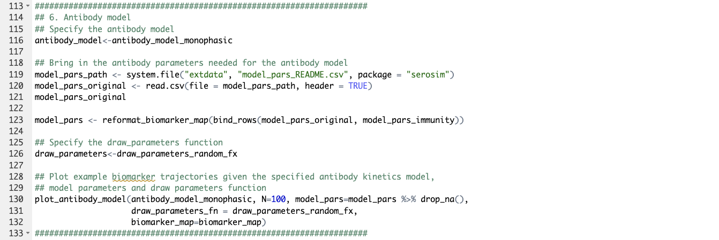
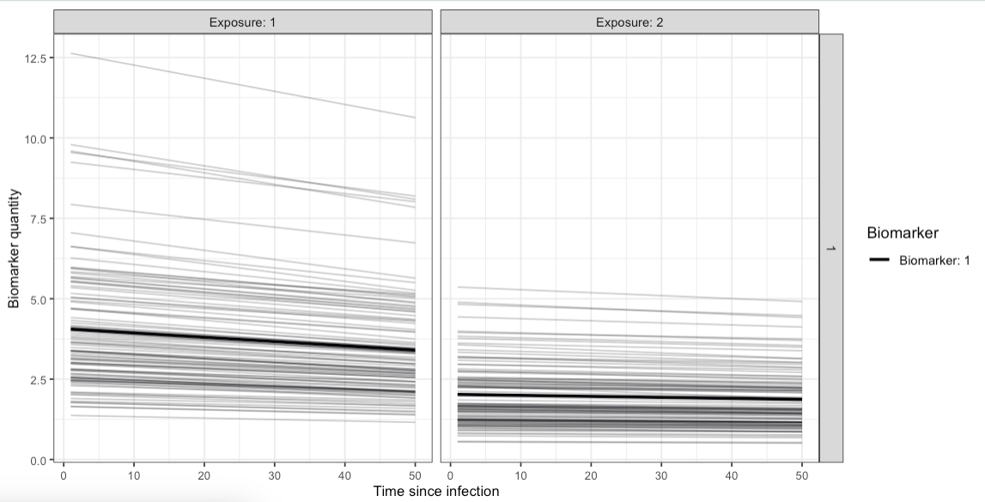

Slide 45
True antibody level to biomarker
t=1
0 | 1 | 0 | 1 | 0 | 0 | 0 | 0 | 0 | 0 | 0 | 0 | 0 | 0 | 0 | 0 | 0 | 0 | 0 | 0 | 0
0 | 0 | 0 | 0 | 0 | 0 | 0 | 0 | 0 | 0 | 0 | 0 | 0 | 0 | 0 | 0 | 1 | 0 | 0 | 0 | 0
t=120
Notes:
Next up we have the immunity model

Slide 46
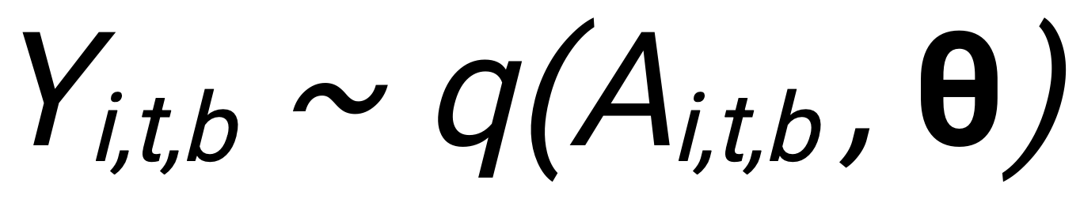
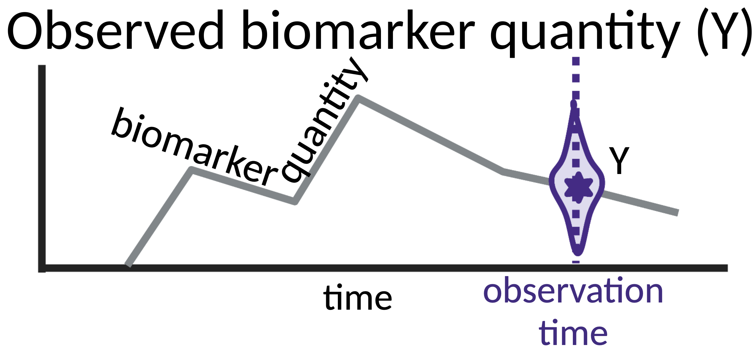
The observation model indicates how observed biomarker quantity Y are generated given the true, latent biomarker quantity A
Discretized
Continuous
False positives
False negatives
Sample degradation, contamination, etc
Bounded
Random error
Simplest model
Varying levels of complexity
Complex model
Notes:
Lastly, we have the observation model which indicates how……
where Yi,t,b, the observed quantity of biomarker b for individual i at time t, is a function q specified by the observation model which specifies which distribution to draw the observed quantity where the true biomarker quantity Ai,t,b is the mean and the Ө includes the standard deviation as well as any parameters governing assay specificity and sensitivity.
To match their assay of choice, users can incorporate assay detection limits like lower bounds, upper bounds, and assay output (discrete vs. continuous titers) within observation_model (S8 Table). Users can also incorporate assay sensitivity, specificity and assay noise within the observation_model.
Noise can be easily added by sampling from a distribution with the true biomarker quantity, A, as the mean and the measurement error as the standard deviation such that Y_{i,t,b} ~ N(A_{i,t,b} ,Ө) where Ө is the standard deviation specified within model_pars as the “obs_sd” parameter.
Lastly, users can set the sampling design for the serological survey by indicating the timepoints, individuals and biomarkers to sample from with the observation_times input.

Slide 47
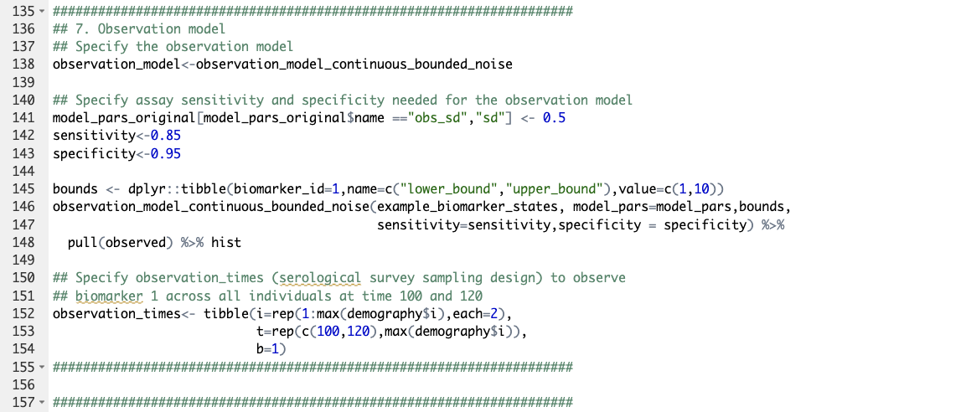

Slide 48
Observed antibody titer
t=1
t=120
Notes:
Next up we have the immunity model

Slide 49


Slide 50
Full model
Probability of vaccination
Probability of exposure
Observed antibody titer
Immunity vs. infection
True antibody level to biomarker
t=1
0 | 1 | 0 | 1 | 0 | 0 | 0 | 0 | 0 | 0 | 0 | 0 | 0 | 0 | 0 | 0 | 0 | 0 | 0 | 0 | 0
0 | 0 | 0 | 0 | 0 | 0 | 0 | 0 | 0 | 0 | 0 | 0 | 0 | 0 | 0 | 0 | 1 | 0 | 0 | 0 | 0
t=120
Notes:
Next up we have the immunity model

Slide 51

Arthur Menezes
E_{i,t,x} = exposure state with exposure type x in individual i at time t
φ_{i,t,x} = probability of seroresponse to exposure x in individual i at time t
Z_{i,t,x} = seroresponse state with exposure type x in individual i at time t
Z_{i,j<t,x} = seroresponse history with exposure type x in individual i by time t
A_{i,t,b} = true level of biomarker b in individual i at time t
Y_{i,t,b} = measurement of biomarker b in individual i at time t
Similar framework proposed in:
Borremans et al. Methods in Ecology and Evolution 2023
Pepin et al. Ecology Letters 2017
Rydevik PLOS Comp Biol 2016
Borremans et al. PLOS Comp Biol 2016
Menezes et al. PLOS Comp Biol 2020 https://doi.org/10.1371/journal.pcbi.1011384
Notes:
In serosim, users can simulate the generative process responsible for observed antibody levels and produce serological data of varying complexity.
The generative processes which serosim allows the user to specify include the population-level processes which govern rates of exposure; the within-host processes which determine immunity and latent antibody kinetics; and the observation process which dictates the relationship between observed and true biomarker quantities.
Our tour will take a quick pit stop within each section to offer you a closer look at each model and a quick look at the customization available to the user at each step. But before that I just wanted to do two things :

Slide 52


Slide 53




Slide 54
Limitations
Asking users to write their own functions in our syntax might be too ambitious
Exposure generating process is currently independent of individual states
The data-generating processes for some pathogens are poorly understood
Correlates of protection
The relationship between time-since-infection and multiple biomarkers
Modern multiplex serological assays are not yet well understood
There is also a trade-off between framework flexibility and computational speed (problem for custom code)

Slide 55
Future directions
More model options and more defaults
Pathogen-specific plugins
“I need to simulate a cross-sectional measles survey in a low-vaccination coverage setting”
Ideally speed ups
Use serosim to generate a suite of representative serosurveys and compare performance of existing inference methods (e.g., serocatalytic models)

Slide 56
Practical 2: Rsero

Slide 57
Practical 3: serosolver

Slide 58

How do we perform inference from these data?
Traditional thresholds of 4-fold rise¹
Time-since-infection models^{2,3,4}
Complex models require consideration of multiple sources of elevated titers⁵
Cross-reactivity
Measurement error/strain effects
1. Cauchemez et al. 2012 PLoS Pathog 8(12):e1003061 doi: 10.1371/journal.ppat.1003061
2. Pepin et al. 2017 Ecol Lett 20(3):275-292 doi: 10.1111/ele.12732
3. Simonsen et al. 2009 Statistics in Medicine https://doi.org/10.1002/sim.3592
4. Ranjeva et al. 2019 Nat Commun 10, 1660 (2019). https://doi.org/10.1038/s41467-019-09652-6
5. Salje et al. Nature 2018 https://doi.org/10.1038/s41586-018-0157-4

Slide 59


serosolver case studies
Case study 1: longitudinal measurements of homologous, single strain titres
Case study 2: cross-sectional measurements of multi-strain panel
Hay et al. PLOS Comp Biol 2020 https://doi.org/10.1371/journal.pcbi.1007840
Notes:
Two case studies for typical serosurvey design

Slide 60
E_{i,t,x} = exposure state with exposure type x in individual i at time t
φ_{i,t,x} = probability of seroresponse to exposure x in individual i at time t
Z_{i,t,x} = seroresponse state with exposure type x in individual i at time t
Z_{i,j<t,x} = seroresponse history with exposure type x in individual i by time t
A_{i,t,b} = true level of biomarker b in individual i at time t
Y_{i,t,b} = measurement of biomarker b in individual i at time t
Menezes et al. PLOS Comp Biol 2020 https://doi.org/10.1371/journal.pcbi.1011384
Notes:
In serosim, users can simulate the generative process responsible for observed antibody levels and produce serological data of varying complexity.
The generative processes which serosim allows the user to specify include the population-level processes which govern rates of exposure; the within-host processes which determine immunity and latent antibody kinetics; and the observation process which dictates the relationship between observed and true biomarker quantities.
Our tour will take a quick pit stop within each section to offer you a closer look at each model and a quick look at the customization available to the user at each step. But before that I just wanted to do two things :

Slide 61

Multi-level model – serosolver
For all individuals
in sample
For all time periods in
this individual’s life
$P\left(A,Z,Θ\right|Y)∝\prod_{i=1}^{n}{\left(\prod_{t∈t_{obs}}{P(Y_{i,t,b}|A_{i,t,b},θ}\right)\prod_{j=j_{min}}^{j_{max}}{P\left(A_{i,j,b} | Z_{i,j≤t,x},θ_{i}\right)P(Z_{i,t,x}|Φ_{i,t,x},}}Z_{i,j<t,x}$,$θ_{i})P\left(Φ_{i,t,x} | λ_{t,x}\right)P\left(λ\right)P(Θ)$
The distribution we want to sample from
1) Observation level
Distribution of observations of biomarker b given true antibody level at time t
2) Within-host level
Distribution of true biomarker levels b at each time point j given exposure history and model
3) Immunity level
Probability of infection/vaccination given exposure history/immunity
4) Transmission level
Probability of exposure given FOI
Biomarker 1
Biomarker 2
.
.
Biomarker b
Exposure 1
Exposure 2
.
.
Exposure n
Similar framework proposed in:
Borremans et al. Methods in Ecology and Evolution 2023
Pepin et al. Ecology Letters 2017
Rydevik PLOS Comp Biol 2016
Borremans et al. PLOS Comp Biol 2016
serosim: Menezes et al. PLOS Comp Biol 2023 https://doi.org/10.1371/journal.pcbi.1011384
Hay et al. PLOS Comp Biol 2020 https://doi.org/10.1371/journal.pcbi.1007840
Notes:
Fit model to titres (Y) for many individuals using MCMC to estimate multiple model levels:
Probability of infection (Φ)
Individual infection histories per 3-month window (Z) (latent feature estimation)
Antibody kinetics including waning and cross-reactivity determined by an antigenic map (Θ)
Observation model including random and systematic measurement error (Θ)

Slide 62

Questions we’d like to answer with serological data
Serostatus – was this person previously infected?
$P(Z_{i}=1|Y_{i})$
What is the time-since infection of a sample?
$P(Z_{i,t−j}|Y_{i,t})$
What were the historical dynamics (infections, vaccination etc) which led to the current serological landscape?
$P\left(Z, φ \right|Y)$
What can we learn about immunological mechanisms based on the distribution of biomarker levels?
$P\left(A_{i} \right|Z_{i}, θ)$
Can we infer correlates of protection?
$P(Z_{i}|φ,A_{i})$
Can we quantify the current immune landscape of a particular pathogen?
$P(A|Y)$
Including multiplex measurements
$\prod_{b}{P\left(Y_{i,b} | A_{i,b}\right)P(A_{i,b}|Z_{i})} Z∈ \left\{Exposure 1, Exposure 2, Exposure 3,…,Exposure N\right\}$
Biomarker 1
Biomarker 2
.
.
Biomarker m
Exposure 1
Exposure 2
.
.
Exposure n

Slide 63

Expected antibody titers conditional
on individual infection history
Likelihood of infection history conditional on FOI
$$P\left(A,Z,Θ\right|Y)∝\left(\prod_{i=1}^{n}{\left(\prod_{t∈t_{obs}}{f(Y_{i,t}|Z_{i,1},Z_{i,2},…,Z_{i,t},θ}\right)\prod_{j=j_{min}}^{j_{max}}{P(Z_{i,j}|Φ_{j}}})\right)P\left(Φ\right)P(Θ)$$

Slide 64
serosolver case studies
Case study 1: longitudinal measurements of homologous, single strain titres
Case study 2: cross-sectional measurements of multi-strain panel
Hay et al. PLOS Comp Biol 2020 https://doi.org/10.1371/journal.pcbi.1007840
16
Notes:
Two case studies for typical serosurvey design

Slide 65

serosolver: example using simulated longitudinal data
One individual
Simulated infection time
Hay et al. PLOS Comp Biol 2020 https://doi.org/10.1371/journal.pcbi.1007840

Slide 66

serosolver: example using simulated longitudinal data
Assess model-predicted latent titres (dark shaded) and assay measurements (light shaded)
Re-estimate known infection times (orange vs. black line)
ω
µ_{s}
µ_{l}
Hay et al. PLOS Comp Biol 2020 https://doi.org/10.1371/journal.pcbi.1007840

Slide 67
serosolver: example using simulated longitudinal data
Assess model-predicted latent titres (dark shaded) and assay measurements (light shaded)
Re-estimate known infection times (orange vs. black line)
Re-estimate known process parameters (green line)
ω
µ_{s}
µ_{l}
Hay et al. PLOS Comp Biol 2020 https://doi.org/10.1371/journal.pcbi.1007840

Slide 68
serosolver: example using simulated longitudinal data
Assess model-predicted latent titres (dark shaded) and assay measurements (light shaded)
Re-estimate known infection times (orange vs. black line)
Re-estimate known process parameters (green line)
Inferred attack rate (blue) vs. known, simulated attack rate (green)
ω
µ_{s}
µ_{l}
Hay et al. PLOS Comp Biol 2020 https://doi.org/10.1371/journal.pcbi.1007840
Hay et al. PLOS Comp Biol 2020 https://doi.org/10.1371/journal.pcbi.1007840

Slide 69
Re-estimating the exposure histories from our simulated data using serosolver
Notes:
Aim is just to show the range of methods out there, not to be able to reproduce each one

Slide 70
1. Input data
5. Output diagnostics
a) Serological data
a) MCMC convergence
4. Output posteriors
b) Covariates
a) Infection histories
b) Model fits
3. serosolver
b) Antibody kinetics parameters
2. Model decisions
a) Infection history model and prior
6. Output estimates
c) Attack rates
a) Epidemiological dynamics
b) Antibody kinetics model priors
b) Immunological processes
c) Observation model

Slide 71
Model fitting
All models are mis-specified, of course…
We want to do a better job than seroconversion in calling unobserved exposures
We fit a latent-state model accounting for antibody kinetics to the simulated data
We get antibody kinetics parameter estimates and augmented infection states for each individual
… HOWEVER

Slide 72
Model fitting
All models are mis-specified, of course…
We want to do a better job than seroconversion in calling unobserved exposures
We fit a latent-state model accounting for antibody kinetics to the simulated data
We get antibody kinetics parameter estimates and augmented infection states for each individual
… HOWEVER
The time-resolution of the model is coarser than the data-generating-process (12 time periods)
We just call “exposures”, not vaccination or infection
We estimate exposures without considering the immunity model
No random effects on the antibody kinetics
We have pretty incomplete observations

Slide 73
RStudio demonstration

Slide 74
Discussion
How accurately did we pick up and time the past exposures?
How should we interpret out antibody kinetics parameter estimates?
How accurate are our population-level estimates?
How well did our model explain/fit to the data?

Slide 75
serosolver features
Different infection history prior versions
Additional antibody kinetics parameters
Biomarker-specific measurement offsets
Support for multiple biomarker types (e.g., antibody titers and avidities)
Features in the works
Immunity model
Group-level antibody kinetics and attack rates
More flexible force-of-infection model
Fix known biomarker states
Account for non-zero starting titers

Slide 76



Acknowledgements
Steven Riley
Adam Kucharski
Justin Lessler
Derek Cummings
Bingyi Yang
Kin On Kwok
Huachen Zhu
Chao Qiang Jiang
Yi Guan
Jonathan Read
Arthur Menezes
Isobel Routledge
Saki Takahashi
Jess Metcalf
Andrea Graham

Slide 77
Thank you!
Notes:
Aim is just to show the range of methods out there, not to be able to reproduce each one

Slide 78

Seroepidemiology
Measure prevalence of biomarkers of infection or vaccination to estimate:
Burdens of disease
Theoretical herd immunity/vaccination coverage
Identify populations for supplemental vaccination campaigns
Duration of immunity
Elimination targets
Image from: Benefits and Challenges in Using Seroprevalence Data to Inform Models for Measles and Rubella Elimination
Winter et al. 2018 J Infect Dis DOI: 10.1093/infdis/jiy137
Notes:
Durable signal, directly linked to immunity, “R” compartment of SIR models

Slide 79

Seroepidemiology
Measure prevalence of biomarkers of infection or vaccination to estimate:
Burdens of disease
Theoretical herd immunity/vaccination coverage
Identify populations for supplemental vaccination campaigns
Duration of immunity
Elimination targets
See:
Image from: Benefits and Challenges in Using Seroprevalence Data to Inform Models for Measles and Rubella Elimination
Winter et al. 2018 J Infect Dis DOI: 10.1093/infdis/jiy137
Notes:
Trop Med Int Health
. 2016 Sep;21(9):1086-98.
doi: 10.1111/tmi.12737.

Slide 80

Some key immunology terms
Antigen (influenza HA)
Serology: measurement of biomarkers related to a pathogen from serum or other sample (plasma sample)
Antibody: large, Y-shaped protein which binds to antigen (the “variable” end) and can be bound by effector cells (the “Fc” end)
Antigen: overall protein target of the immune system (e.g., histidine rich protein 2 in malaria)
Epitope: specific part of an antigen bound by an antibody (i.e., a short amino acid sequence)
Immunoglobulin: there are 5 different isotypes (classes) of antibody which show up at different points post infection. We usually measure IgG, which is a good long-lived marker. IgM only shows up through primary infection. IgA shows up on mucosal surfaces.
Variable region
Epitope
Fc
region
Knight et al. Immunological Reviews 2020 https://doi.org/10.1111/imr.12900
Notes:
Glutamate dehydrogenase

Slide 81

Some key immunology terms
Assay: lab tool/technique to process and analyze substance of interest
Biomarker/analyte/antibody level: some quantitative measure of the assay target
Titer: X-fold dilution series of the sample. The reported value is usually the highest dilution (weakest concentration) that still performs some biological function (e.g., neutralizes virus in an assay)
Affinity: measure of biochemical binding strength between an antibody and an epitope
Avidity: avidity over lots of antibody/epitope interactions
Haemagglutination inhibition assay
Image from https://www.virology.ws/2009/05/27/influenza-hemagglutination-inhibition-assay/

Slide 82

Types of data
Binary serostatus
e.g., lateral flow test, binarized HI titer
Categorical serostatus (naïve, low titer, high titer etc)
e.g., N-component mixture model applied to titer distribution
(Top) Lateral flow test used in REACT 2: Wong et al. Communications Medicine 2022 https://doi.org/10.1038/s43856-022-00146-z

Slide 83

Types of data
Binary serostatus
e.g., lateral flow test, binarized HI titer
Categorical serostatus (naïve, low titer, high titer etc)
e.g., N-component mixture model applied to titer distribution
Single-target (semi-)quantitative titer/level/neutralization
e.g., ELISA optical density, fold dilution
(Top) Lateral flow test used in REACT 2: Wong et al. Communications Medicine 2022 https://doi.org/10.1038/s43856-022-00146-z
(Middle) Example IgG ELISA measurements: Rassheed et al. PNAS 2019 https://doi.org/10.1073/pnas.1905570116

Slide 84

Types of data
Binary serostatus
e.g., lateral flow test, binarized HI titer
Categorical serostatus (naïve, low titer, high titer etc)
e.g., N-component mixture model applied to titer distribution
Single-target (semi-)quantitative titer/level/neutralization
e.g., ELISA optical density, fold dilution
Multiplex (1) multiple titers/measurements to various epitopes from same or different pathogen
e.g., ELISA panels, HI panels for influenza
Multiplex (2) single assay giving measurement of multiple biomarkers
e.g., protein microarray, PhIP-Seq/VirScan
(Top) Lateral flow test used in REACT 2: Wong et al. Communications Medicine 2022 https://doi.org/10.1038/s43856-022-00146-z
(Middle) Example IgG ELISA measurements: Rassheed et al. PNAS 2019 https://doi.org/10.1073/pnas.1905570116
(Bottom) Example VirScan output: Xu et al. Science 2015 DOI: 10.1126/science.aaa0698

Slide 85

A general framework for serological data generation
Antibody level
Snapshot serological measurement
Notes:
Show HMM from thesis
Talk about how exposures are hidden events
The set, timing and order of these hidden events determines an individual’s exposure history
Exposure history governs latent immunological state, which in context of serology are latent antibody/B-cell levels
We have noisy and imperfect snapshots of these latent antibody levels through sampling – they are incomplete, but we can model the stages

Slide 86
A general framework for serological data generation
Time
Latent immunological state
Snapshot serological measurement
TSI=t-j
Notes:
Show HMM from thesis
Talk about how exposures are hidden events
The set, timing and order of these hidden events determines an individual’s exposure history
Exposure history governs latent immunological state, which in context of serology are latent antibody/B-cell levels
We have noisy and imperfect snapshots of these latent antibody levels through sampling – they are incomplete, but we can model the stages

Slide 87
A general framework for serological data generation
Immunity as a function of latent immunological state
Latent immunological state
Snapshot serological measurement
TSI=t-j
Notes:
Show HMM from thesis
Talk about how exposures are hidden events
The set, timing and order of these hidden events determines an individual’s exposure history
Exposure history governs latent immunological state, which in context of serology are latent antibody/B-cell levels
We have noisy and imperfect snapshots of these latent antibody levels through sampling – they are incomplete, but we can model the stages

Slide 88
A general framework for serological data generation
Bernoulli trials for successful infection events
Parameters governing the within-host process
Immunity as a function of latent immunological state
Latent immunological state
Snapshot serological measurement
TSI=t-j
Notes:
Show HMM from thesis
Talk about how exposures are hidden events
The set, timing and order of these hidden events determines an individual’s exposure history
Exposure history governs latent immunological state, which in context of serology are latent antibody/B-cell levels
We have noisy and imperfect snapshots of these latent antibody levels through sampling – they are incomplete, but we can model the stages

Slide 89
A general framework for serological data generation
Population-level FOI/exposure
Bernoulli trials for attempted exposure events
Bernoulli trials for successful infection events
Parameters governing the within-host process
Immunity as a function of latent immunological state
Latent immunological state
Snapshot serological measurement
TSI=t-j
Notes:
Show HMM from thesis
Talk about how exposures are hidden events
The set, timing and order of these hidden events determines an individual’s exposure history
Exposure history governs latent immunological state, which in context of serology are latent antibody/B-cell levels
We have noisy and imperfect snapshots of these latent antibody levels through sampling – they are incomplete, but we can model the stages

Slide 90
A general framework for serological data generation
Not original, but fairly recent:
Hay et al. PLOS Comp Biol 2020
Rydevik PLOS Comp Biol 2016
Borremans et al. PLOS Comp Biol 2016
Pepin et al. Ecology Letters 2017
Population-level FOI/exposure
Bernoulli trials for attempted exposure events
Bernoulli trials for successful infection events
Parameters governing the within-host process
Immunity as a function of latent immunological state
Latent immunological state
Snapshot serological measurement
TSI=t-j
Notes:
Show HMM from thesis
Talk about how exposures are hidden events
The set, timing and order of these hidden events determines an individual’s exposure history
Exposure history governs latent immunological state, which in context of serology are latent antibody/B-cell levels
We have noisy and imperfect snapshots of these latent antibody levels through sampling – they are incomplete, but we can model the stages

